Slide 1
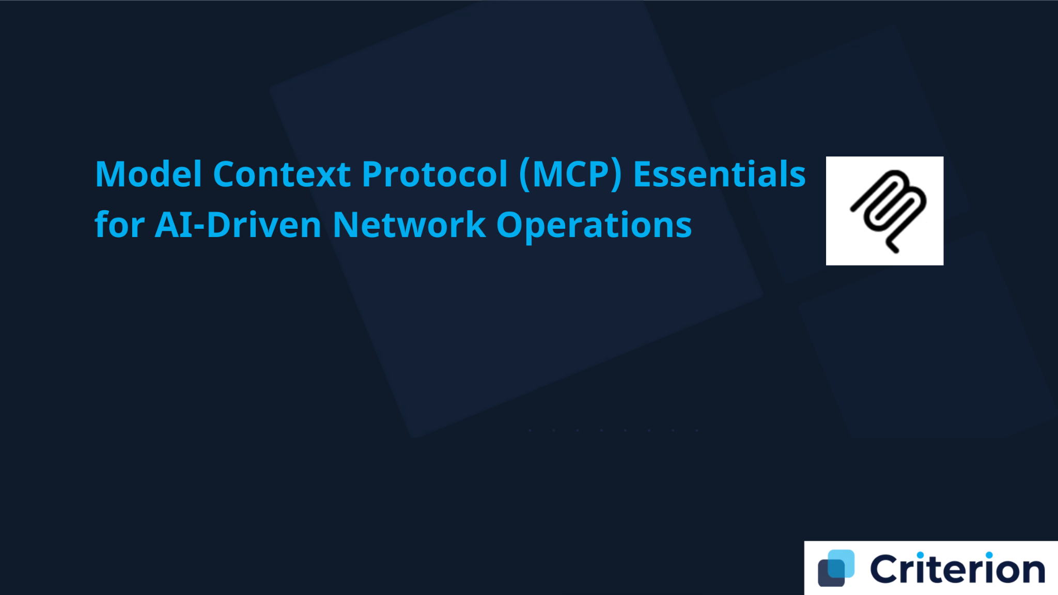


1
Understanding LLMs & AI Applications
Large Language Models, AI-powered applications, and agentic workflows
2
The Integration Challenge
Agenda
API architecture, the MxN problem, and current limitations
3
Introducing Model Context Protocol
MCP architecture, capabilities, and the paradigm shift
4
Technical Implementation
Core capabilities, security, SDKs, and protocol extensions
5
Getting Started & Future Vision
Handson Implementation guide, resources, and the future path

Slide 2

Please share the following:
    Your Name and Job Profile
    AI/ML/MCP exposure so far – Rate yourself (1-5, 1 is a Beginner and 5 an Expert)
    Happy with Agenda?
Logistics
    Coffee breaks & Lunch (bits and bites) !!
    Criterion Network’s SDCloud portal account – is the Sandbox visible ?
1.
Introductions
2. Discovery
4
24
Criterion Proprietary & Confidential

Slide 3

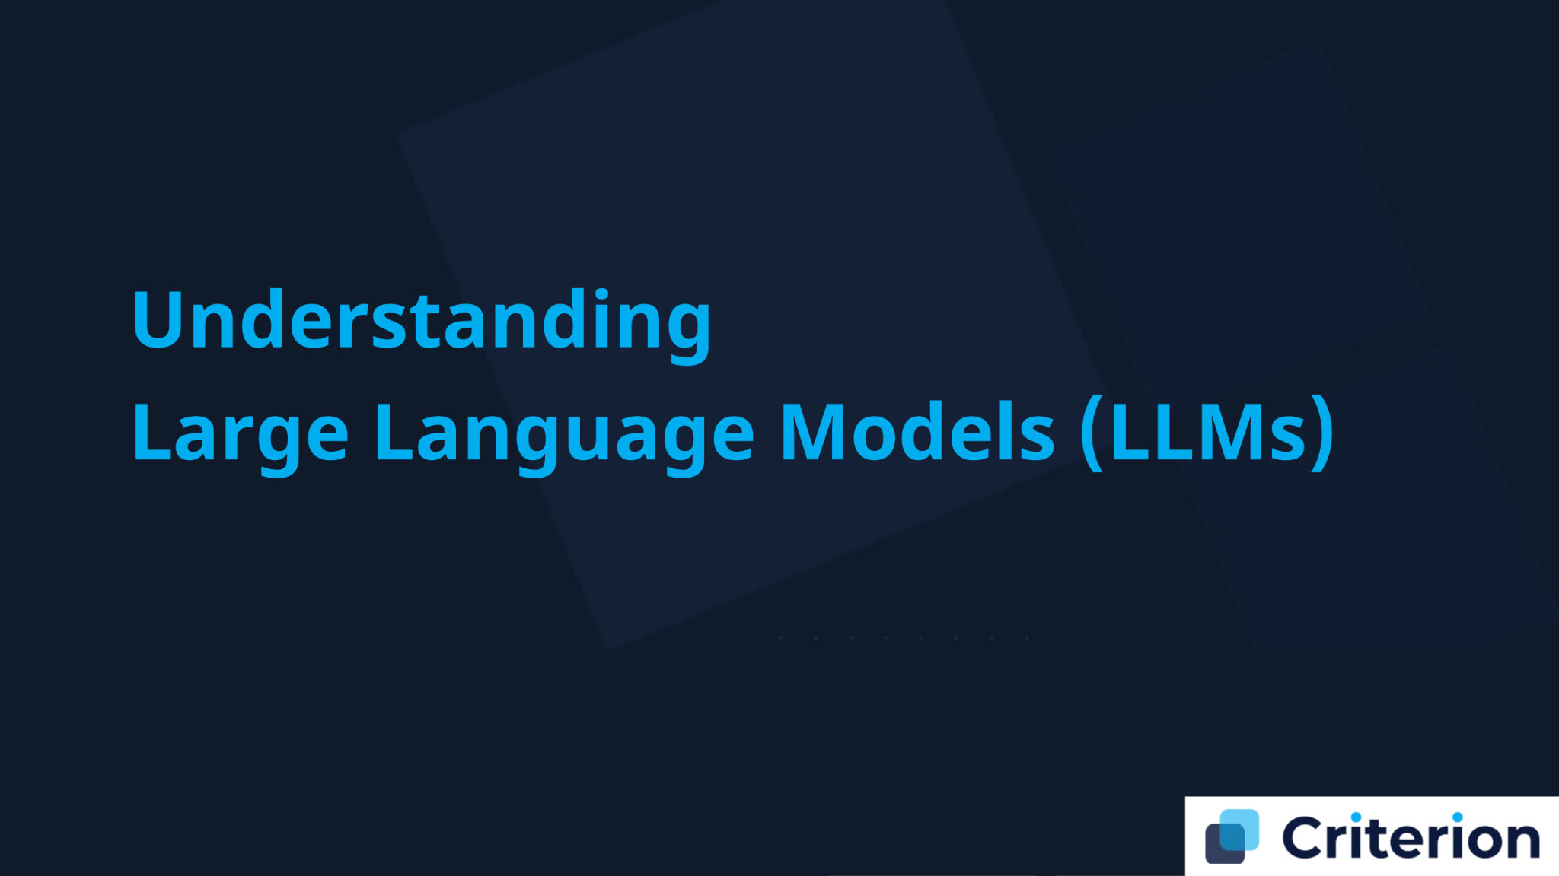

Understanding
Large Language Models (LLMs)

Slide 4



Definition
Large language models (LLMs) are deep learning models trained on immense amounts of data, capable of understanding and generating natural language to perform a wide range of tasks.
What Are
Core Mechanism
Large Language
LLMs work as giant statistical prediction machines that repeatedly predict the next word in a sequence. They learn patterns in text and generate language that follows those patterns.
Models?
Breakthrough Technology
LLMs represent the first AI system that can handle unstructured human language at scale, allowing for natural communication with machines.

Slide 5





Key Components &
Training Process
How LLMs Work: The
Tokenization & Embeddings
Transformer
Architecture
Text is broken into tokens (words/subwords) and mapped to numerical vectors called embeddings that capture semantic meaning.
Self-Attention Mechanism
Each token "pays attention" to other tokens to understand context. The model calculates relationships between all tokens, determining which words matter most to each other.
Built on neural networks called transformers, introduced in 2017
Parameters & Training
LLMs contain billions of parameters (weights) that are optimized through training on massive datasets. The model learns patterns by predicting the next word millions of times.

Slide 6
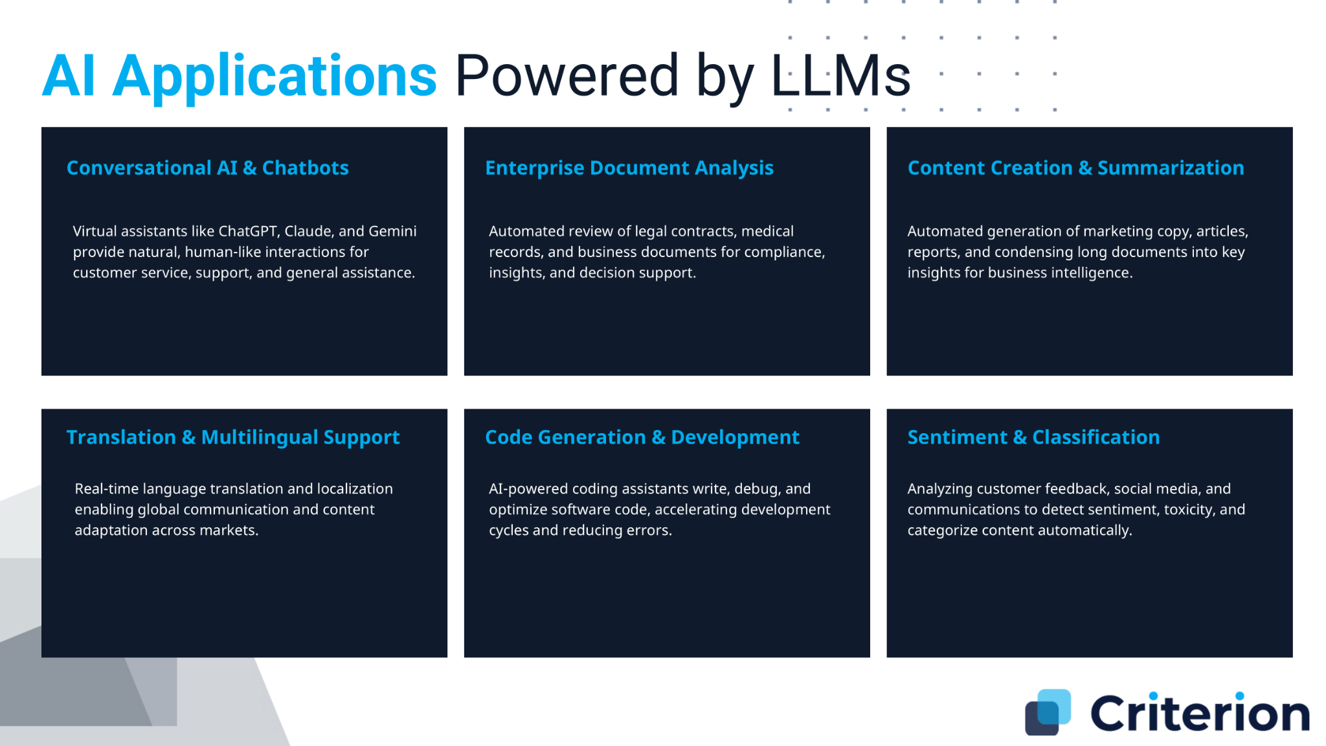

Slide 7
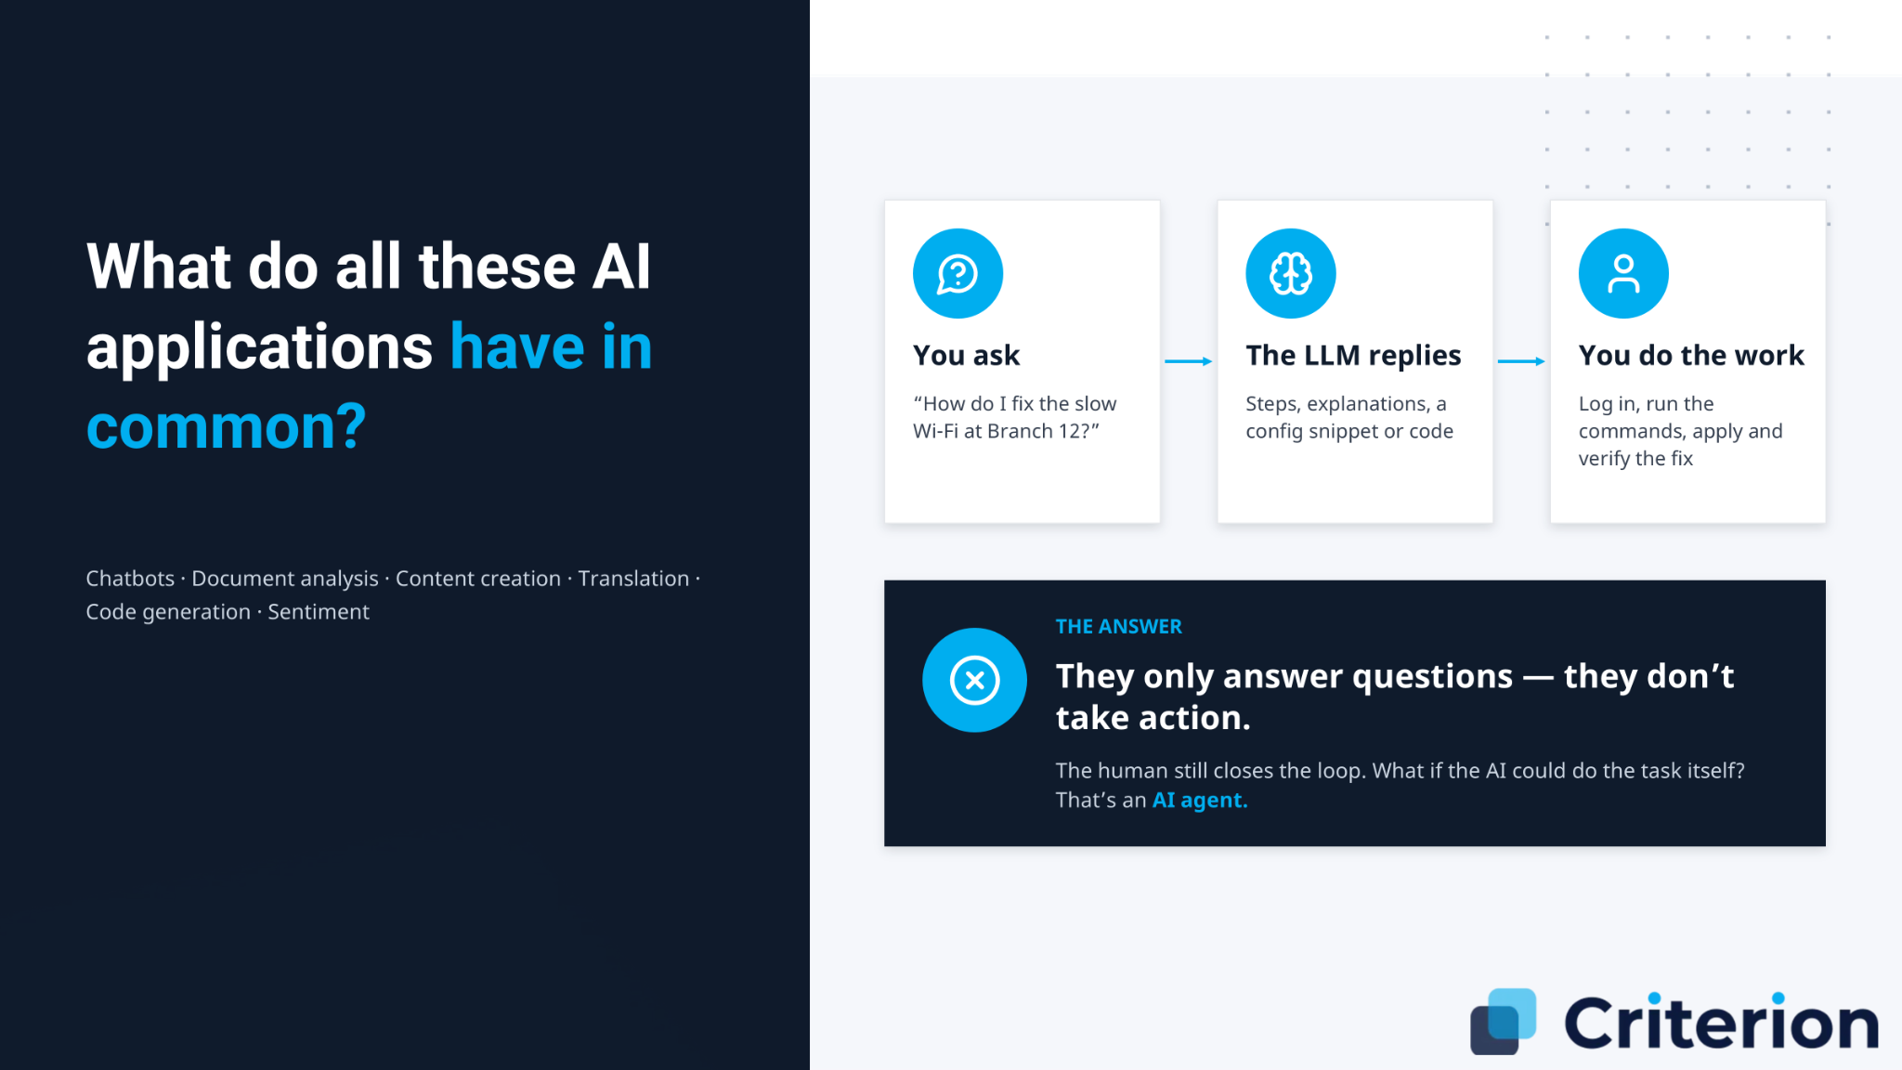

Slide 8
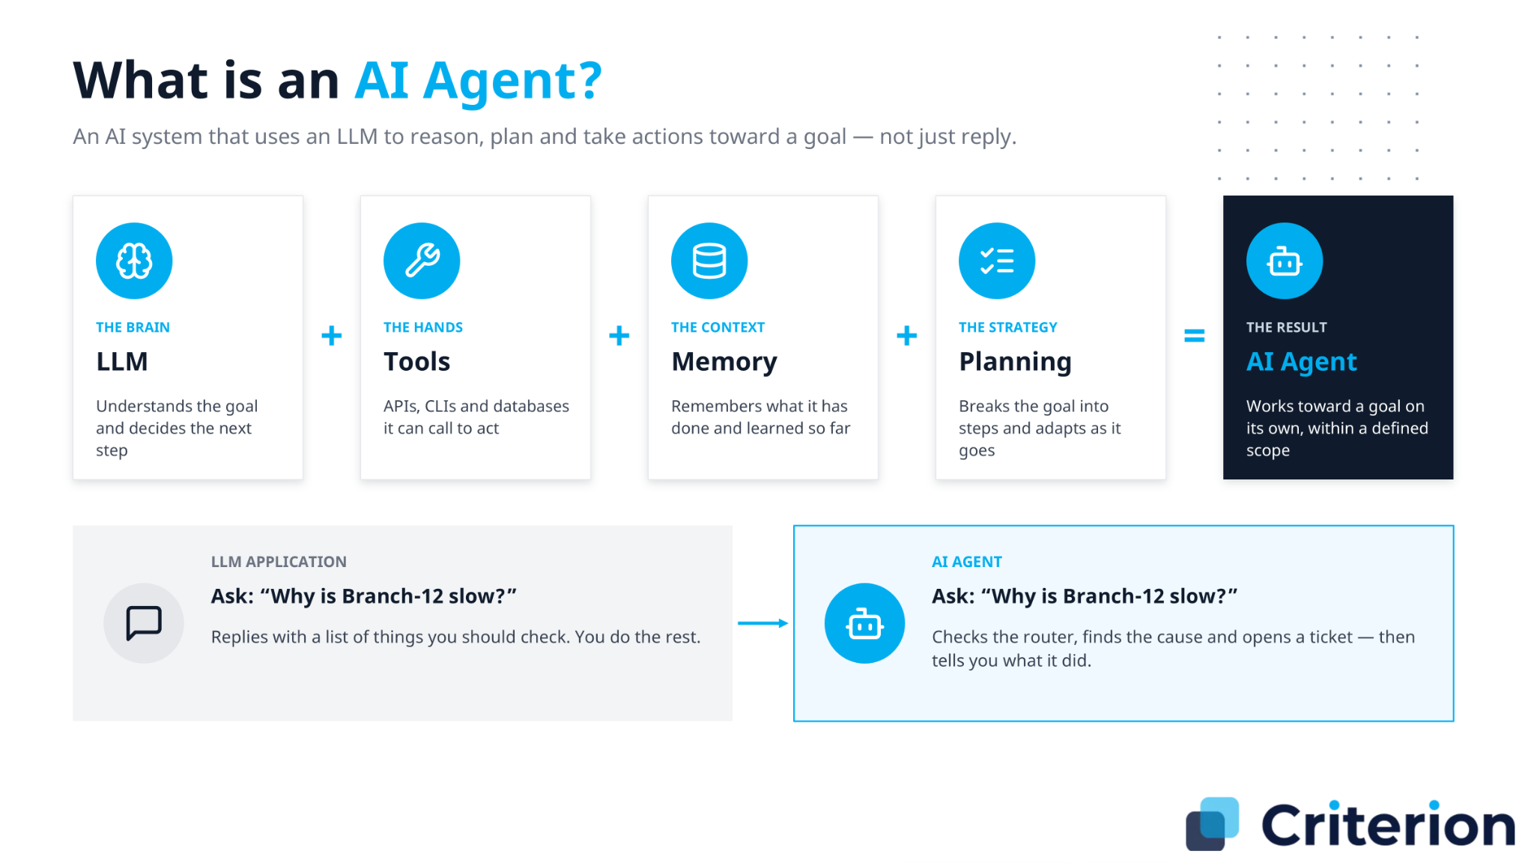

Slide 9
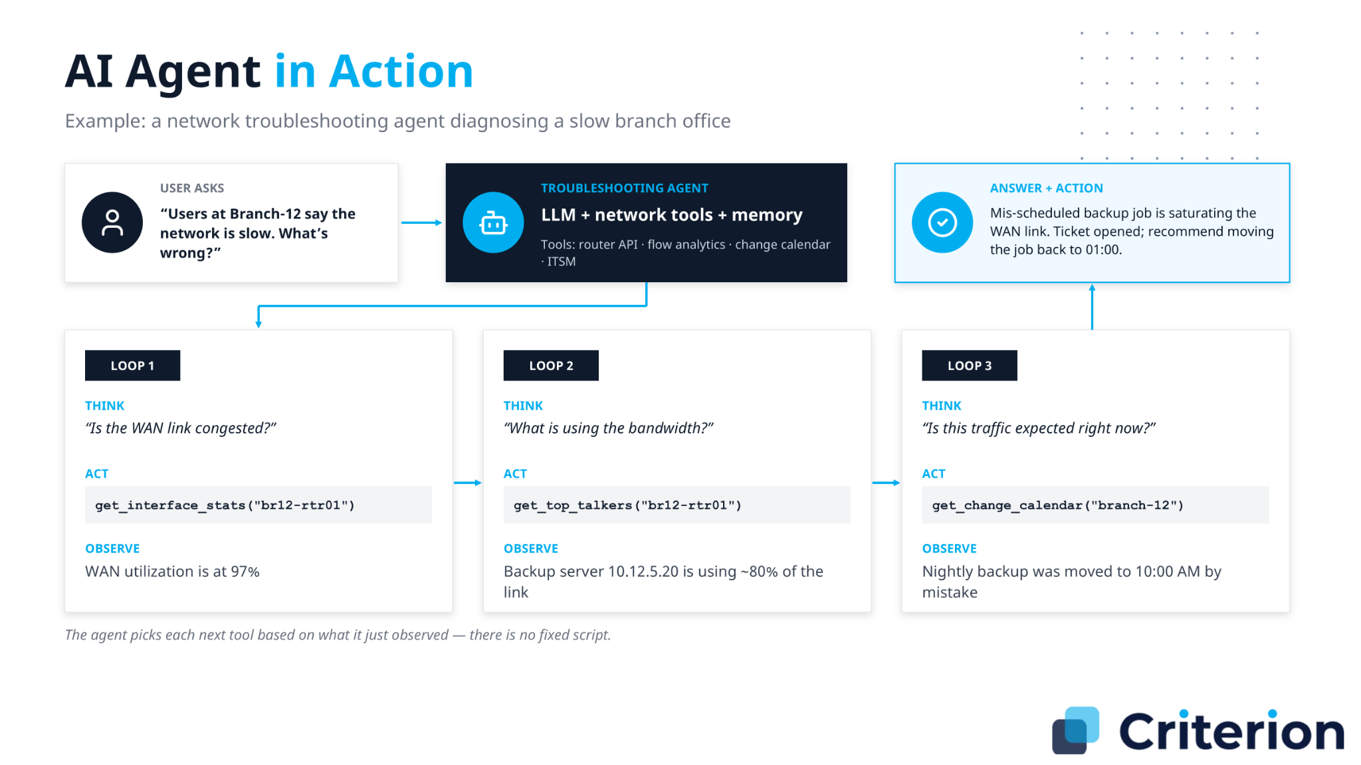

Slide 10
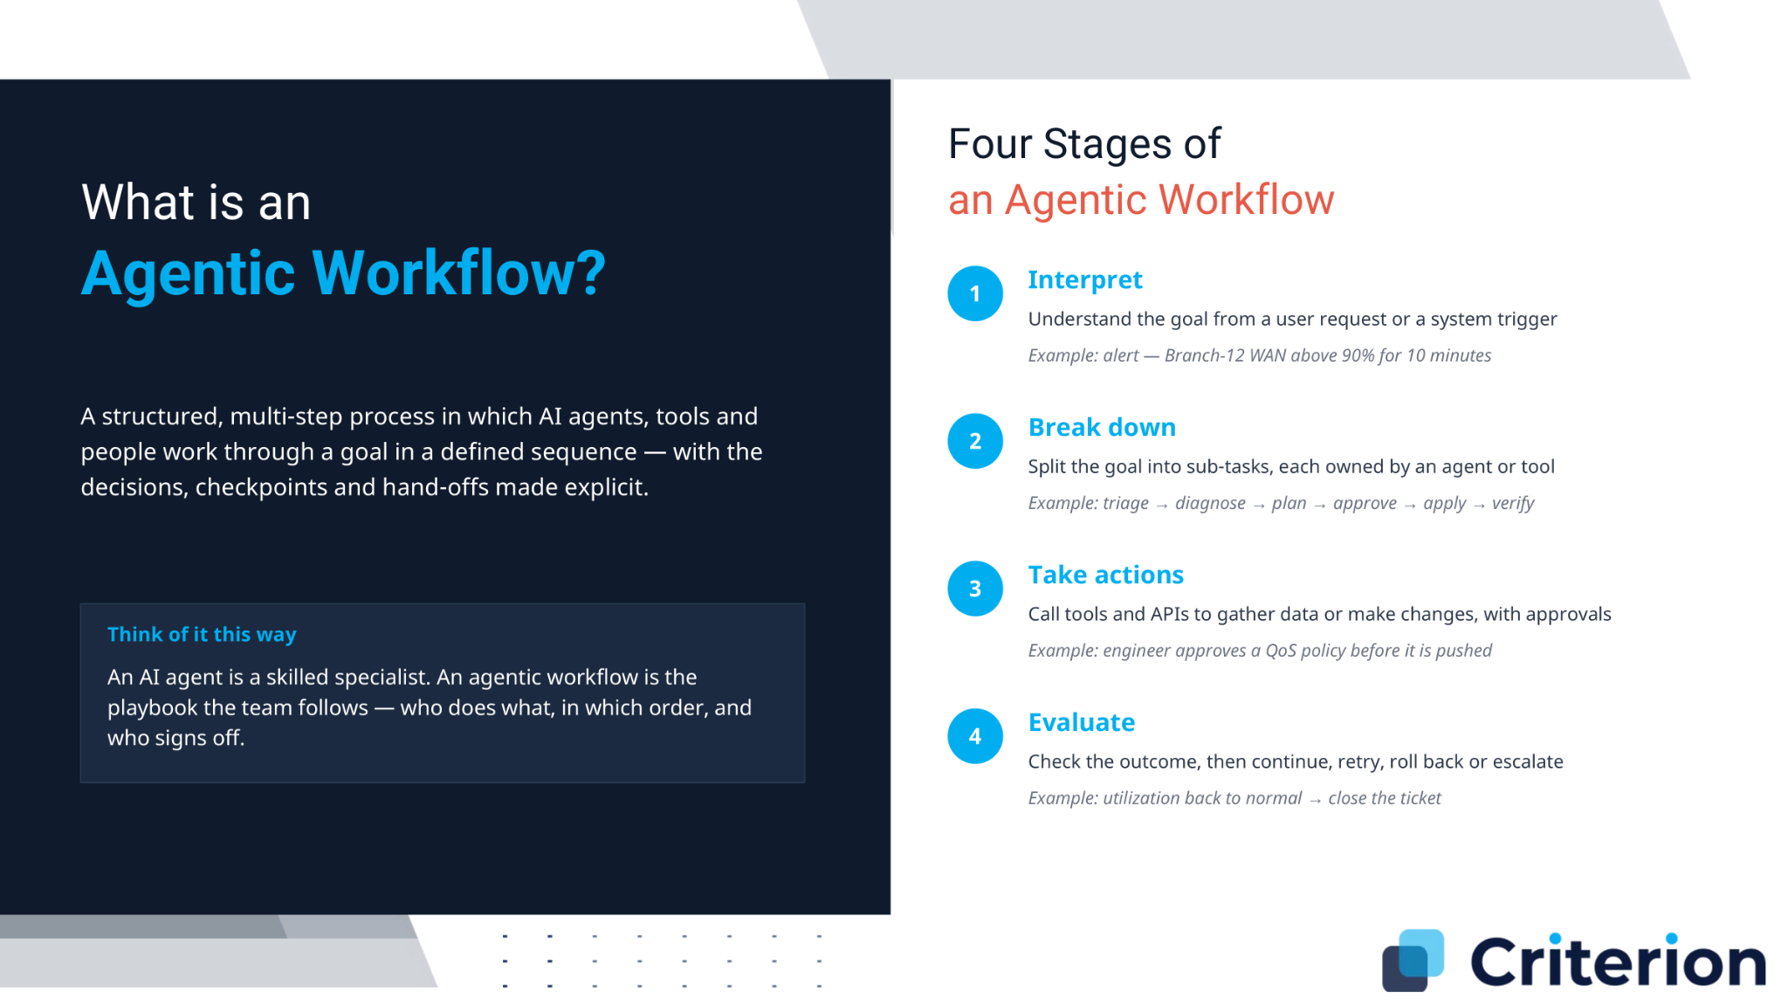

Slide 11
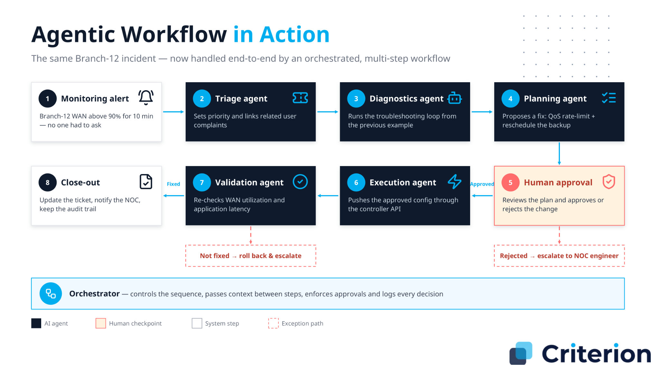

Slide 12
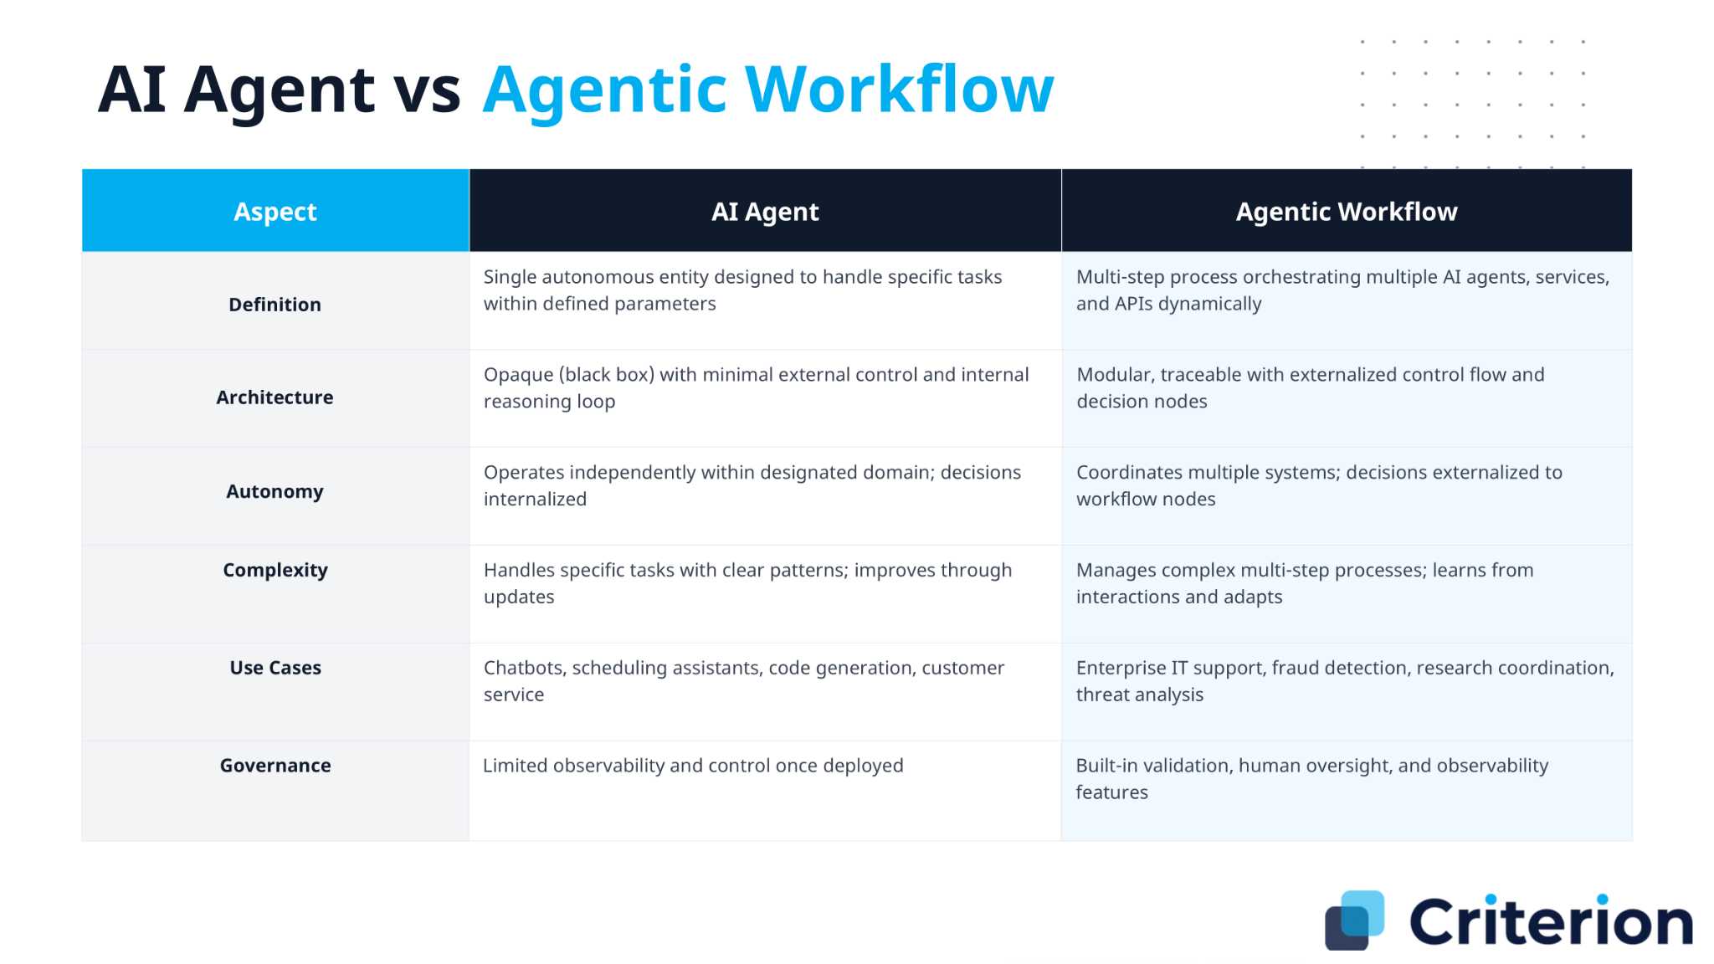

Slide 13
Understanding APIs

Slide 14



How
APIs Work:
Technical Architecture
Request-Response Cycle
Data Formats & Protocols
• Client sends HTTP request to server endpoint
• JSON: Lightweight, human-readable format
• Server processes request and returns HTTP response
• REST: Architectural style using HTTP methods
• Response includes status code, headers, and data payload
• GraphQL: Query language for flexible data retrieval
HTTP Methods & Endpoints
• GET: Retrieve data from server
Stateless Architecture
• POST: Create new resources
• PUT/PATCH: Update existing resources
Each API request is independent and contains all necessary information. The server doesn't maintain session state between requests.
• DELETE: Remove resources
Benefits:
• Scalability: Servers can handle requests without memory overhead
Request Components
• Reliability: No session data loss if server fails
• Simplicity: Easier to cache and distribute requests
• Headers: Metadata (auth tokens, content type)
• Parameters: Query strings or path variables
Authentication:
Typically handled via tokens (JWT, OAuth) passed in
• Body: Data payload (JSON, XML, form data)
headers rather than server-side sessions.

Slide 15
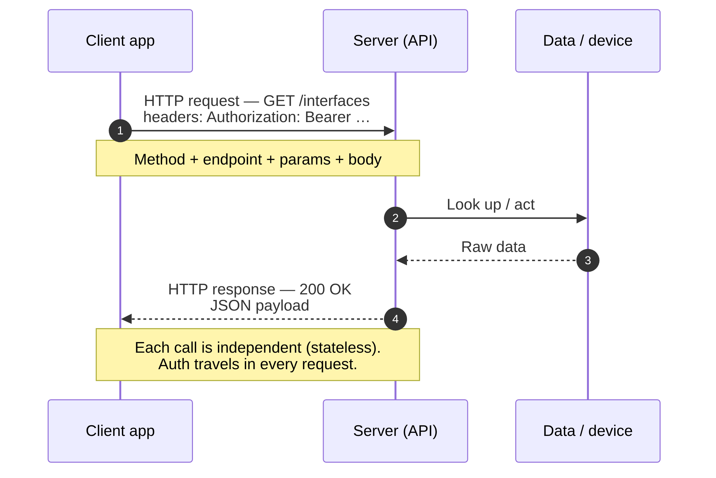
How APIs Work (request/response cycle)
An API call is one round trip — the client asks with a verb + endpoint, the server does the work and answers with a status code and JSON. Every call stands alone.

Slide 16
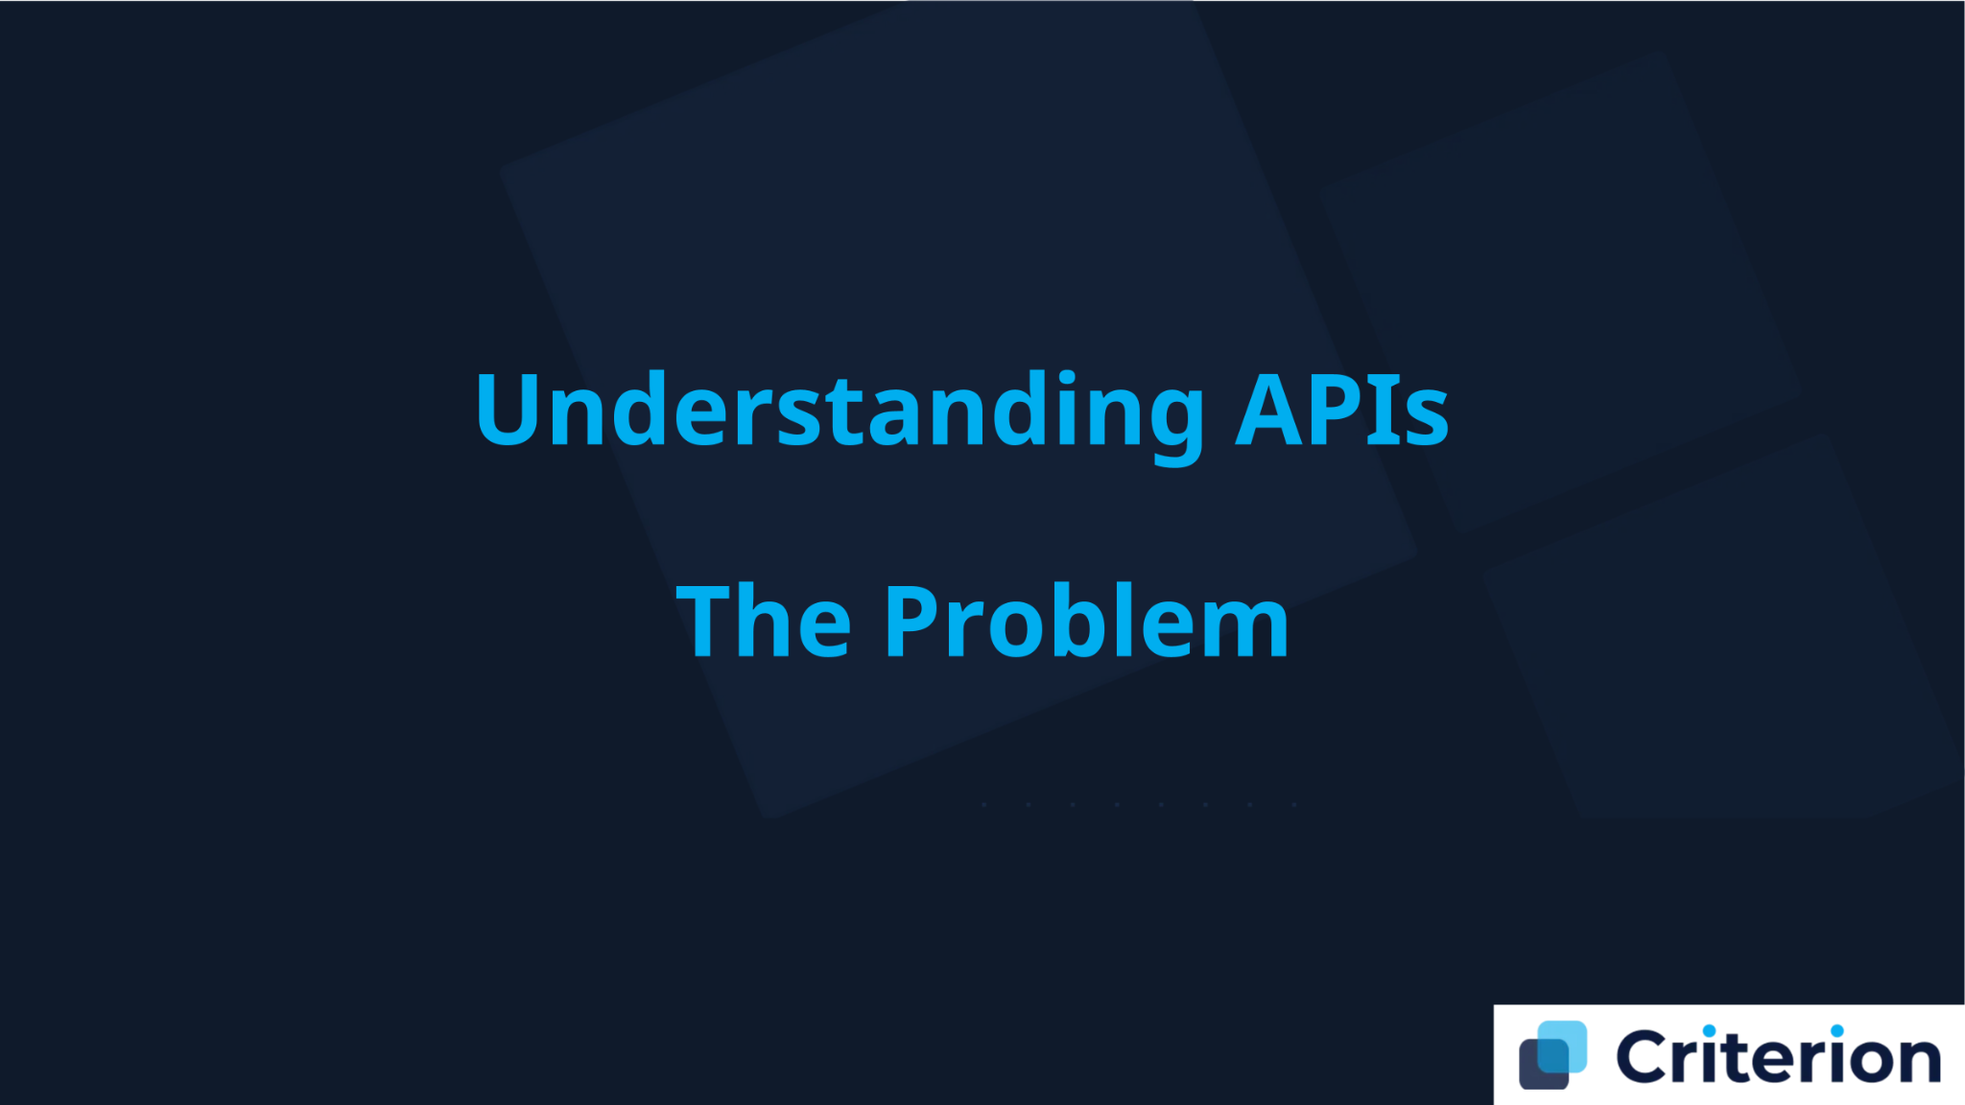

Slide 17
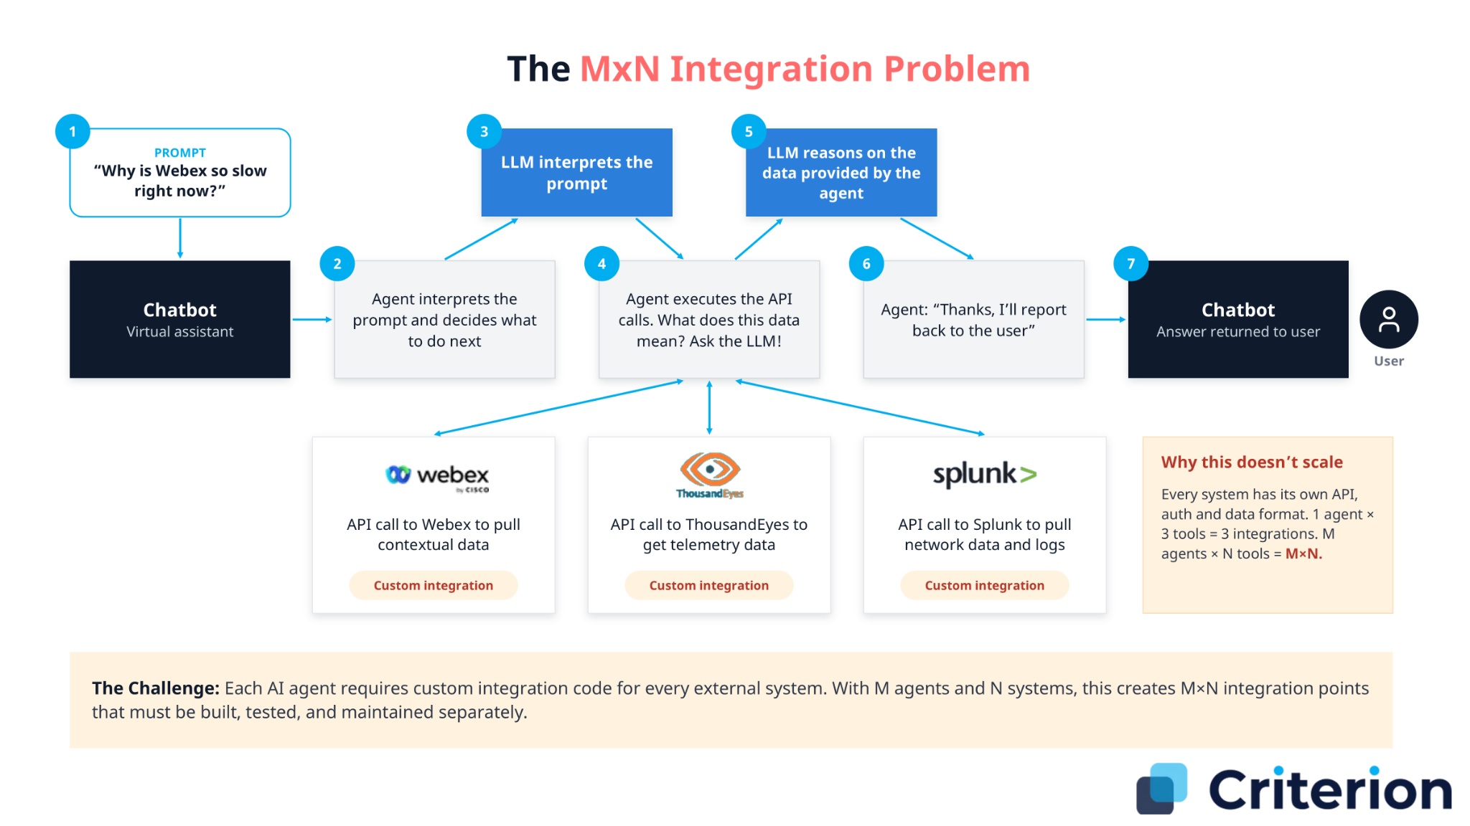

Slide 18



Key
Challenges
The N×M Problem
Connecting N AI applications to M data sources requires building N×M custom integrations. This exponential complexity creates massive technical debt and slows innovation.
The
Integration
Current Pain Points
for AI Tools
• Custom code required for each integration (150+ lines per tool)
Challenge
• Brittle integrations that break with API changes
• Constant maintenance overhead across all connections
• Limited tool discovery and dynamic capability detection
Industry Impact
Organizations spend 60-70% of development time on integration work rather than core AI capabilities. This creates vendor lock-in, siloed solutions, and high barriers to entry for AI adoption.

Slide 19
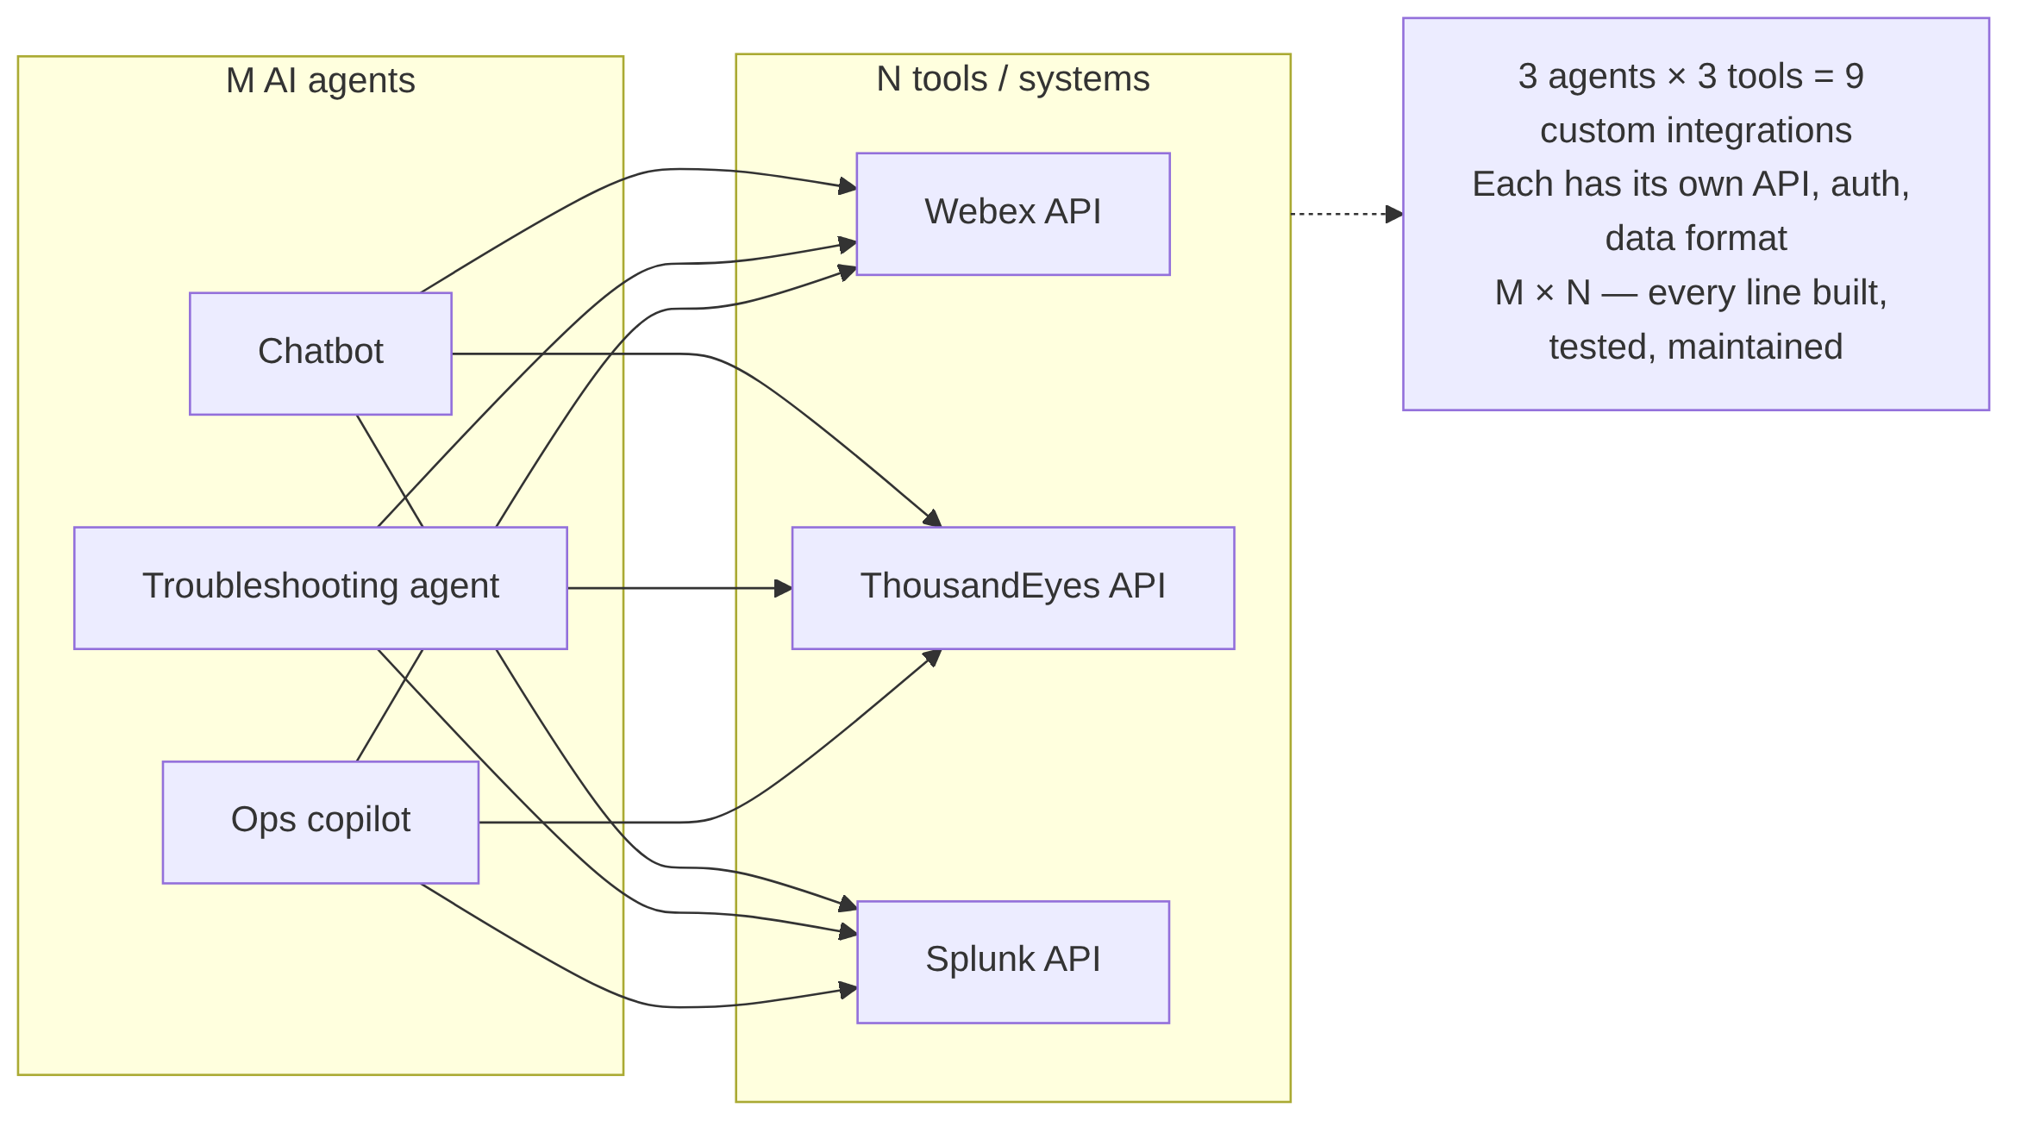
The M×N Integration Problem
Without a standard, every agent needs bespoke glue for every system. 3×3 already = 9 brittle integrations; it grows as M×N.

Slide 20
The MCP Solution:
M+N
APIs & The
MxN Problem
Linear Scaling
MCP reduces complexity from
M×N
to
M+N
by
Connecting
M
AI applications to
N
data sources
introducing a standardized protocol layer.
requires building
M×N
custom integrations.
Example:
Example:
5 AI apps + 10 MCP servers =
15 integrations
5 AI apps × 10 data sources =
50 integrations
This exponential complexity creates massive development overhead, maintenance burden, and integration fragility.
Key Benefits
•
67% reduction
in integration effort (50 → 15)
•
Unified authentication
and error handling
•
Standardized interfaces
across all tools
•
Dynamic discovery
of new capabilities

Slide 21
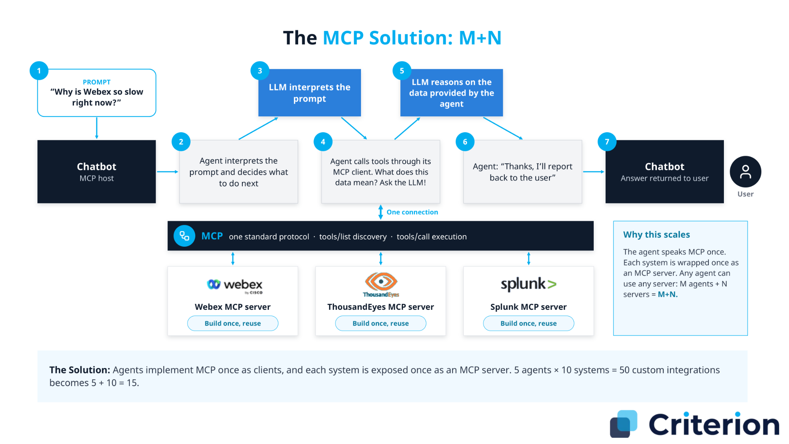

Slide 22
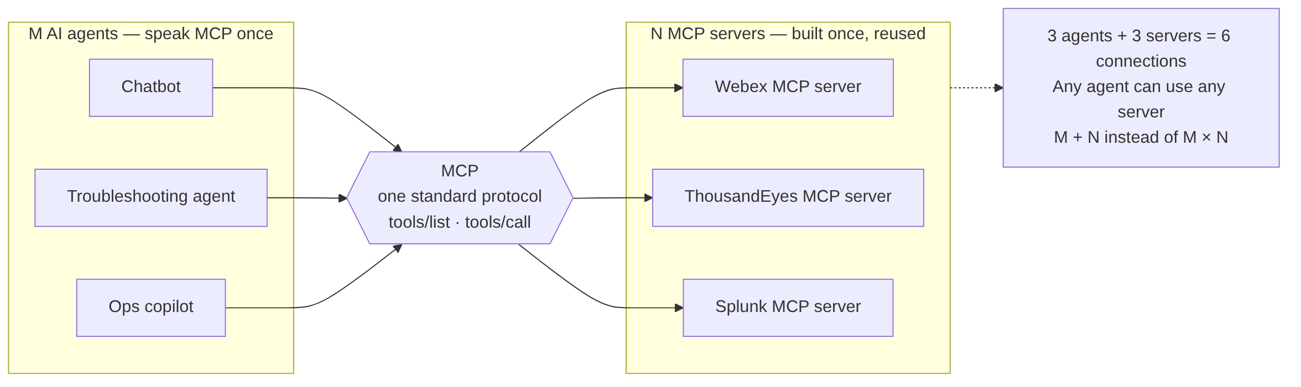
The MCP Solution: M + N
Each agent implements MCP once; each system is wrapped once as an MCP server. 5×10 = 50 custom integrations becomes 5+10 = 15.

Slide 23
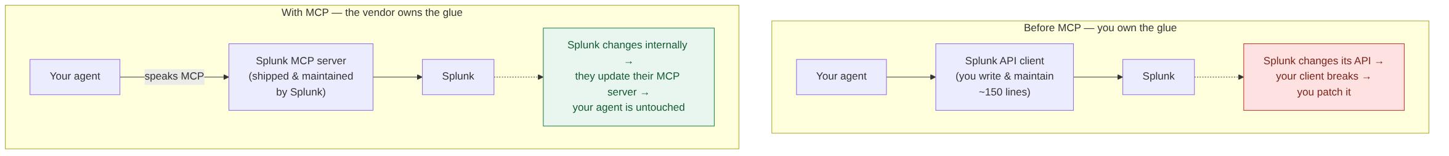
MCP Value Proposition (who maintains the integration?)
When a provider ships its own MCP server, API changes are their problem, not yours. Your agent speaks one protocol and stops chasing breaking integrations.

Slide 24

Standardization protocol for AI tool integration
Definition
"USB-C for AI" - universal connector
NOT an AI assistant or agent
What is
Model
Establish client-server architecture
Context Protocol
Core Purpose
Connect AI applications to external tools
and why does it
Enable dynamic tool discovery
matter
?
Linear scaling (M+N) vs exponential (M×N)
Key Benefits
Unified authentication and error handling
Standardized interfaces across tools

Slide 25
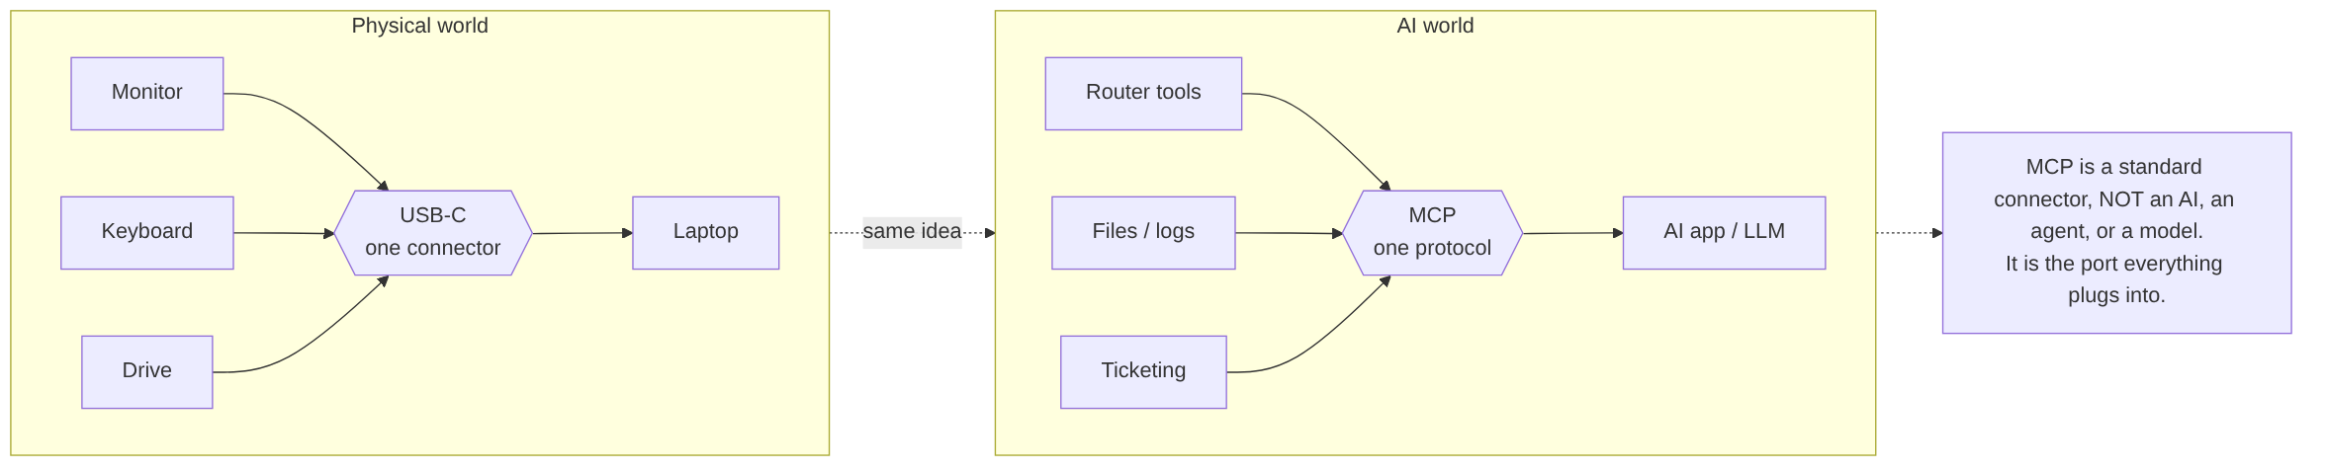
What is MCP? ("USB-C for AI")
USB-C let any device use one port. MCP lets any tool plug into any AI the same way — it's the connector, not the brain.

Slide 26



The MCP
Paradigm Shift
A fundamental transformation in AI tool integration
Before MCP
With MCP
Development
• Custom coding for each integration
• Standardized protocol implementation
• 150+ lines of code per tool
• 5 lines of code for connection
• Multiple authentication systems
• Unified authentication
Maintenance
• Exponential complexity (N×M)
• Linear scalability (M+N)
• Brittle integrations
• Resilient connections
• Constant updates required
• Less maintenance overhead
Innovation
• Siloed solutions
• Interoperable ecosystems
• Vendor lock-in
• Vendor independence
• Limited tool discovery
• Dynamic tool discovery
Adoption
• Technical expertise required
• Accessible AI development
• High barrier to entry
• Democratized integration
• Limited accessibility
• Broader participation
19
Criterion Proprietary & Confidential

Slide 27

Technical Deep Dive
Model Context
Protocol
A standardized protocol for connecting AI applications to external systems, built on JSON-RPC for seamless integration of tools, resources, and prompts.
Protocol Version: 2026-07-28

Slide 28

MCP
Protocol Architecture
Technical components and protocol layers
Core Components
Protocol Layers
Host User-facing AI Application
The user-facing AI application that orchestrates interactions between users, LLMs, and external tools.
Examples: Claude Desktop, Cursor IDE
Data Layer — Client-Server Communication (JSON-RPC)
Defines the JSON-RPC based protocol for client-server communication:
Lifecycle Connection initialization and termination
Primitives Core data structures and messages
Notifications Asynchronous event updates
Client Internal Connector
A component within the Host that maintains a 1:1 connection with a Server, handling MCP communication details.
Transport Layer — Communication Mechanisms
Defines the communication mechanisms between clients and servers:
Stdio Local process communication via standard I/O
Streamable HTTP Remote communication with Streamable HTTP
Server Capability Provider
An external program that exposes capabilities (Tools, Resources, Prompts) via the MCP protocol.
Deployment: Can run locally or remotely.
Protocol Version: 2026-07-28

Slide 29
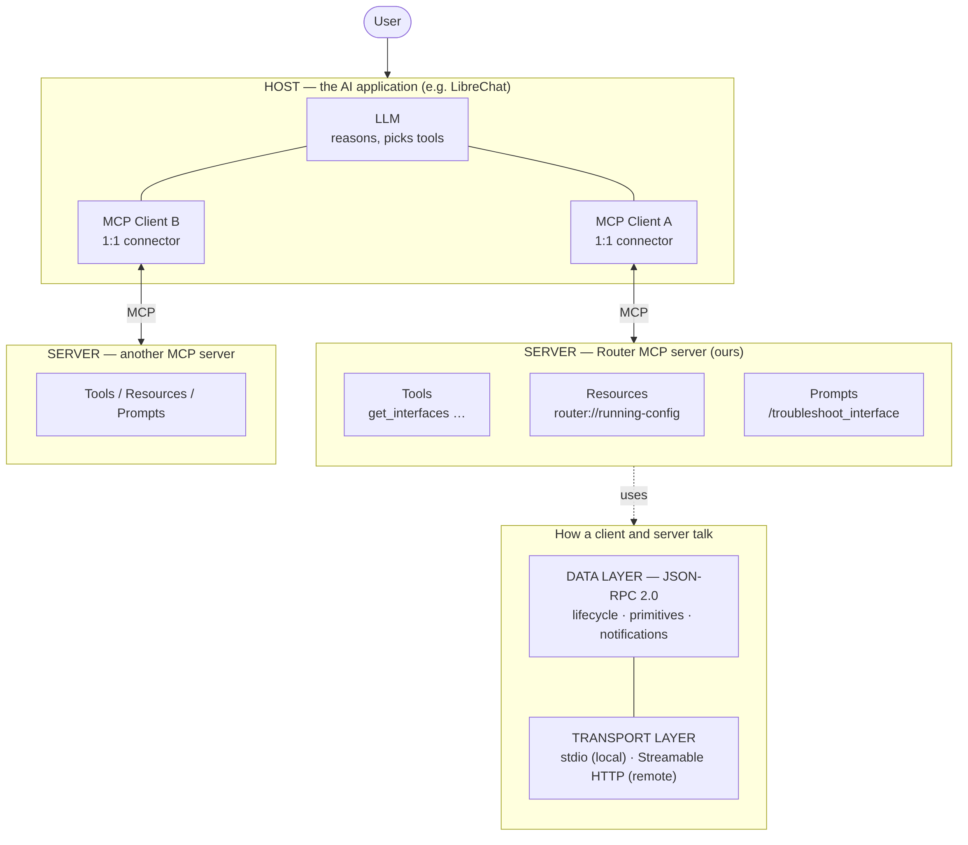
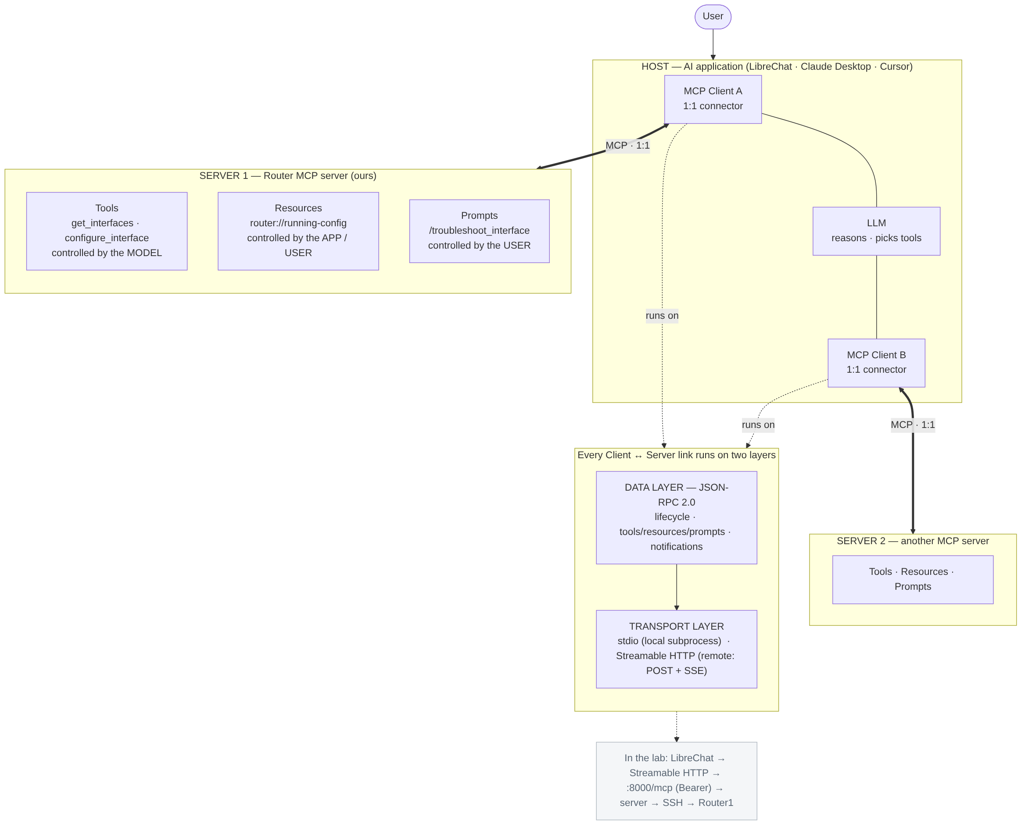
MCP Protocol Architecture (Host / Client / Server + layers)
HOST — AI application (LibreChat · Claude Desktop · Cursor)
MCP Client A
1:1 connector
LLM
reasons · picks tools
MCP Client B
1:1 connector
MCP · 1:1
MCP · 1:1
SERVER 1 — Router MCP server (ours)
SERVER 2 — another MCP server
Tools
Resources
Prompts
Tools · Resources · Prompts
same protocol, built once
get_interfaces · configure_interface
router://running-config
/troubleshoot_interface
controlled by the MODEL
controlled by the APP / USER
controlled by the USER
runs on
Every Client ↔ Server link runs on two layers
DATA LAYER — JSON-RPC 2.0
lifecycle · tools / resources / prompts · notifications
TRANSPORT LAYER
stdio (local subprocess) · Streamable HTTP (remote: POST + SSE)
In the lab: LibreChat → Streamable HTTP → :8000/mcp (Bearer) → MCP server → SSH → Router1 (172.18.2.6)

Slide 30

MCP
Core Capabilities
Standardized protocol primitives for AI-tool integration
build Tools
folder_open Resources
terminal Prompts
Function calling and execution
Execute client-side logic and deterministic operations
Dynamic tool discovery
Runtime capability inspection and real-time listing
Structured input/output schemas
JSON Schema validation for robust type safety
Multi-modal result types
Support for text, image, and embedded content responses
Contextual data access
Expose files, logs, and live application data to models
File and database integration
Standardized URI patterns for heterogeneous sources
Real-time resource updates
Dynamic content updates during active session streams
Subscription-based notifications
Client event listeners for underlying data changes
Template management
Pre-designed prompt templates with standardized formats
Reusable prompt libraries
Centralized workflows shared across tools and applications
Parameterized interactions
Dynamic argument injection for context customization
LLM-agnostic design
Universal prompt compatibility across model providers

Slide 31
Discovery First — tools/list
Before the model can call anything, the client asks the server “what tools do you have?”
The server answers with each tool's name, description and inputSchema — that is how the LLM learns what it can do.
1. Request — client asks
2. Response — server lists its tools
tools_list_request.json
tools_list_response.json
{
"jsonrpc": "2.0",
"id": 1,
"method": "tools/list"
}
{
"jsonrpc": "2.0", "id": 1,
"result": { "tools": [
{
"name": "get_interfaces",
"description": "Get all router
interfaces and status",
"inputSchema": { "type": "object" }
},
{ "name": "configure_interface", … }
] }
}
Discovery (tools/list) comes first → then the client can invoke a specific tool with tools/call — shown on the next slide.

Slide 32





1. Requests
Sent from Client to Server to initiate an operation. Includes an ID, method name, and parameters.
2. Responses
Sent from Server to Client in reply to a Request. Includes the same ID and either a result or an error.
JSON-RPC 2.0 (Part 1 & 2)
The Technical Foundation
MCP's communication protocol implementation
SPECIFICATION
Protocol Version: 2026-07-28
request_payload.json
response_payload.json
{
"jsonrpc": "2.0",
"id": 1,
"method": "tools/call",
"params": {
"name": "weather",
"arguments": {
"location": "San Francisco"
}
}
}
{
"jsonrpc": "2.0",
"id": 1,
"result": {
"temperature": 62,
"conditions": "Partly cloudy"
}
}

Slide 33
3. Notifications
One-way messages that don't require a response. Used primarily for real-time updates or asynchronous events.
JSON-RPC 2.0 (Part 3 of 3)
The Technical Foundation
MCP's communication protocol implementation
SPECIFICATION
Protocol Version: 2026-07-28
notification_payload.json
{
"jsonrpc": "2.0",
"method": "notifications/tools/list_changed"
}
do_not_disturb_on No Request ID
Notifications omit the "id" field entirely. This explicitly signals that no response or acknowledgment is expected from the receiver.
sensors Event-Driven Updates
Enables real-time client sync when server capabilities, resources, or tool definitions change dynamically during an active session.

Slide 34
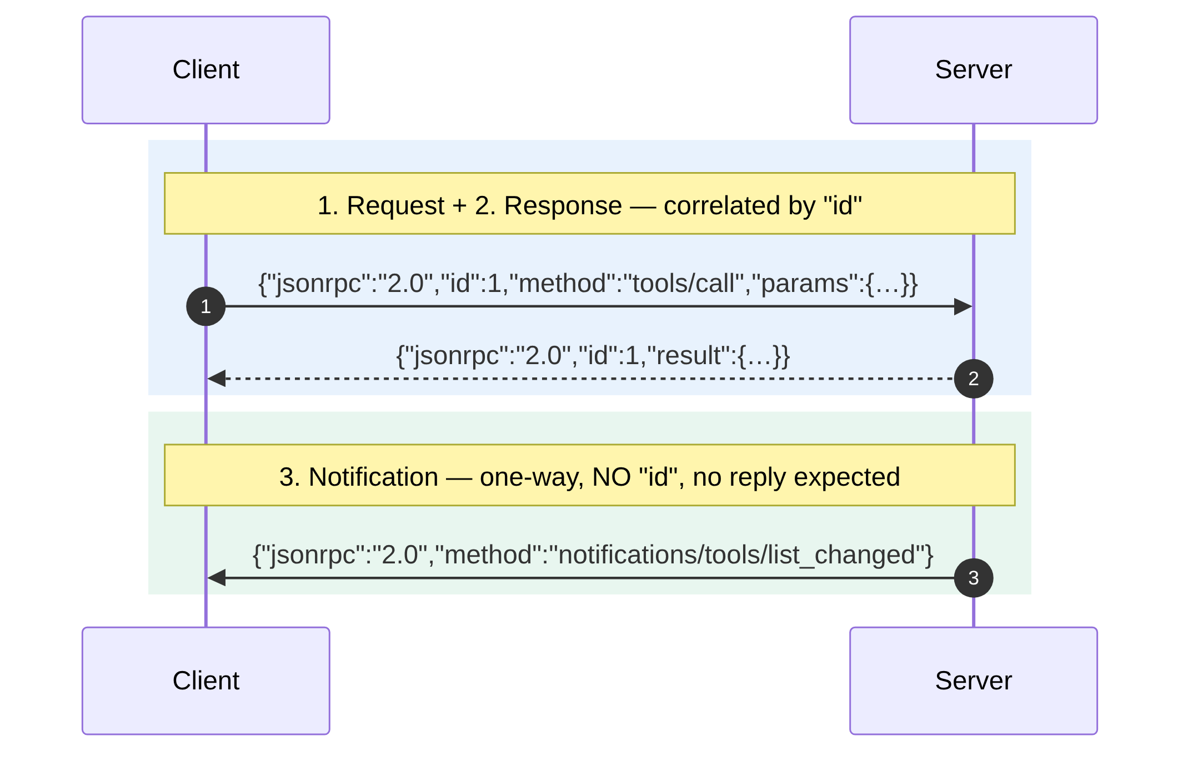
JSON-RPC 2.0 Message Types
Requests carry an `id`; the matching response echoes it. Notifications drop the `id` entirely — fire-and-forget, used for live updates.

Slide 35

MCP Transport Mechanisms
Technical implementation of communication channels
LOCAL COMMUNICATION
Stdio Transport
terminal
REMOTE COMMUNICATION
Streamable HTTP Transport
cloud_queue
Client and Server run on the same machine via standard input/output streams.
Client and Server might be on different machines using HTTP POST with Server-Sent Events.
settings_suggest Implementation
Server launched as subprocess by Host. Client writes to stdin and reads from stdout.
swap_horiz Implementation
Client sends requests via HTTP POST. Server uses SSE for streaming responses and notifications.
speed Technical Benefits
No network config
Low latency
verified_user Authentication Methods
Bearer tokens
API keys
OAuth

Slide 36
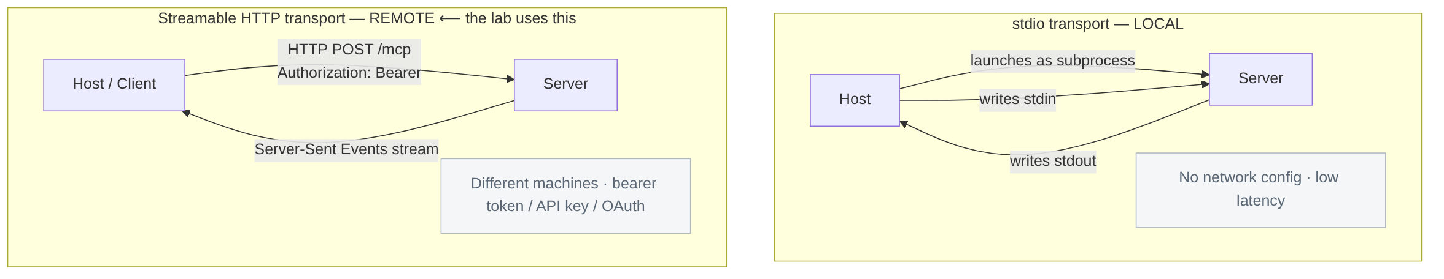
Transport Mechanisms (stdio vs Streamable HTTP)
stdio = server runs as a local subprocess (I/O over pipes). Streamable HTTP = client and server on different machines, POST + SSE, authenticated. Our workshop server runs HTTP at `:8000/mcp` with a bearer token.

Slide 37

MCP Protocol Lifecycle (Phase 1 & 2)
Technical sequence of protocol interactions — Initialization & Discovery
01
Initialization
Client connects to Server and they exchange protocol versions and capabilities.
// Client → Server
{ "jsonrpc": "2.0", "id": 1, "method": "initialize",
"params": { "protocolVersion": "2025-06-18",
"capabilities": { "sampling": {} } } }
02
Discovery
Client requests information about available capabilities (tools, resources, prompts).
// Client → Server
{ "jsonrpc": "2.0", "id": 2, "method": "tools/list" }

Slide 38

MCP Protocol Lifecycle (continued)
Technical sequence of protocol interactions — Phase 3 & 4
03
Execution
Client invokes capabilities based on the Host's needs.
// Client → Server
{ "jsonrpc": "2.0", "id": 3, "method": "tools/call",
"params": { "name": "weather",
"arguments": { "location": "San Francisco" } } }
04
Termination
Connection is gracefully closed when no longer needed.
// Client → Server
{ "jsonrpc": "2.0", "id": 4, "method": "shutdown" }
// After response received:
{ "jsonrpc": "2.0", "method": "exit" }

Slide 39
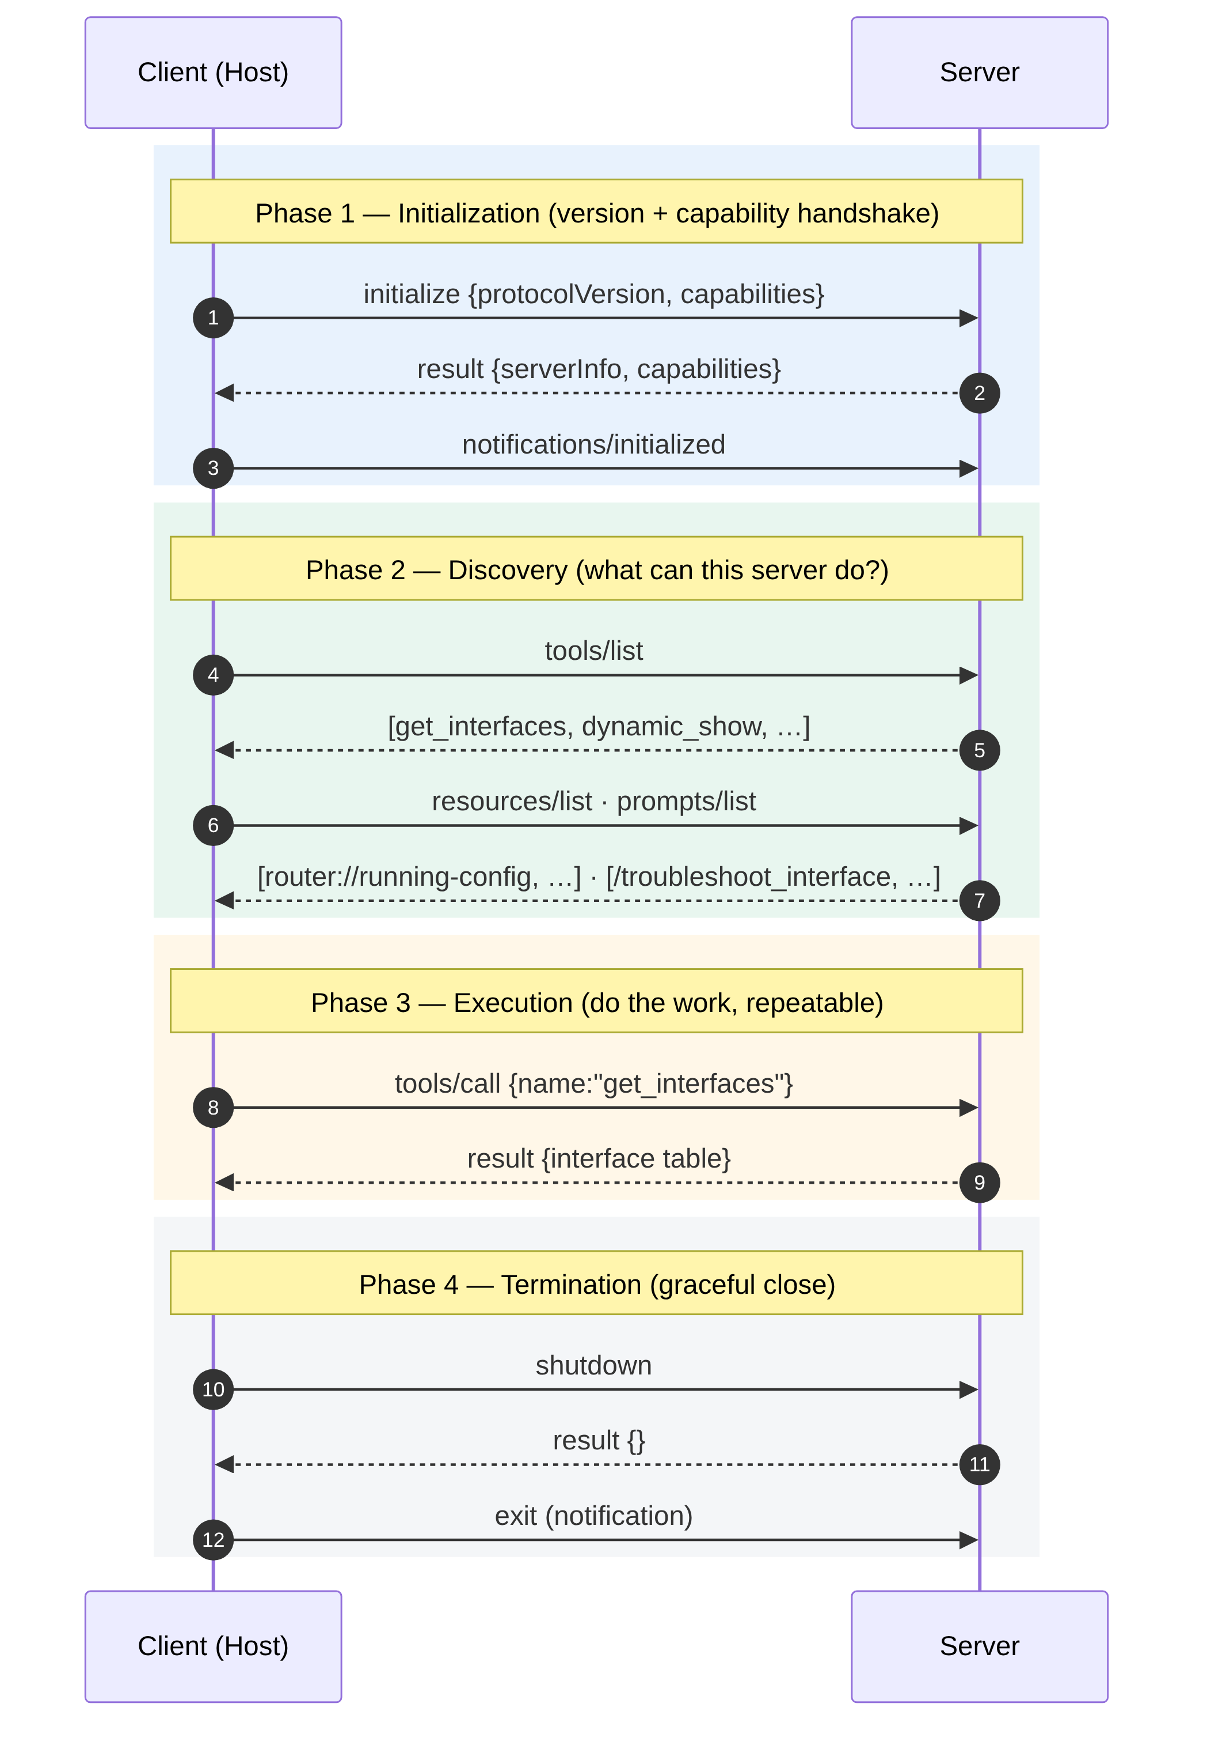
MCP Protocol Lifecycle (all 4 phases)
One session, four phases — shake hands, discover capabilities, call them as needed, then close cleanly.

Slide 40


Slide 41
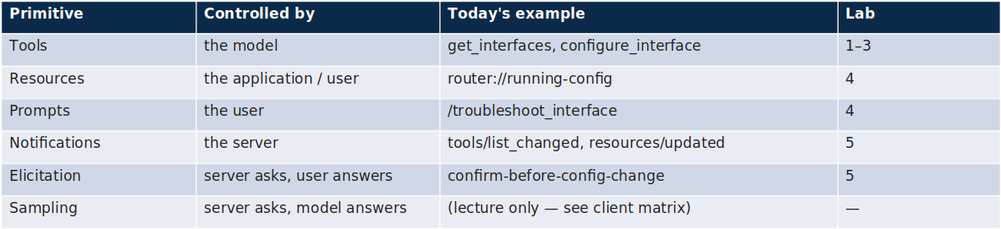

Slide 42
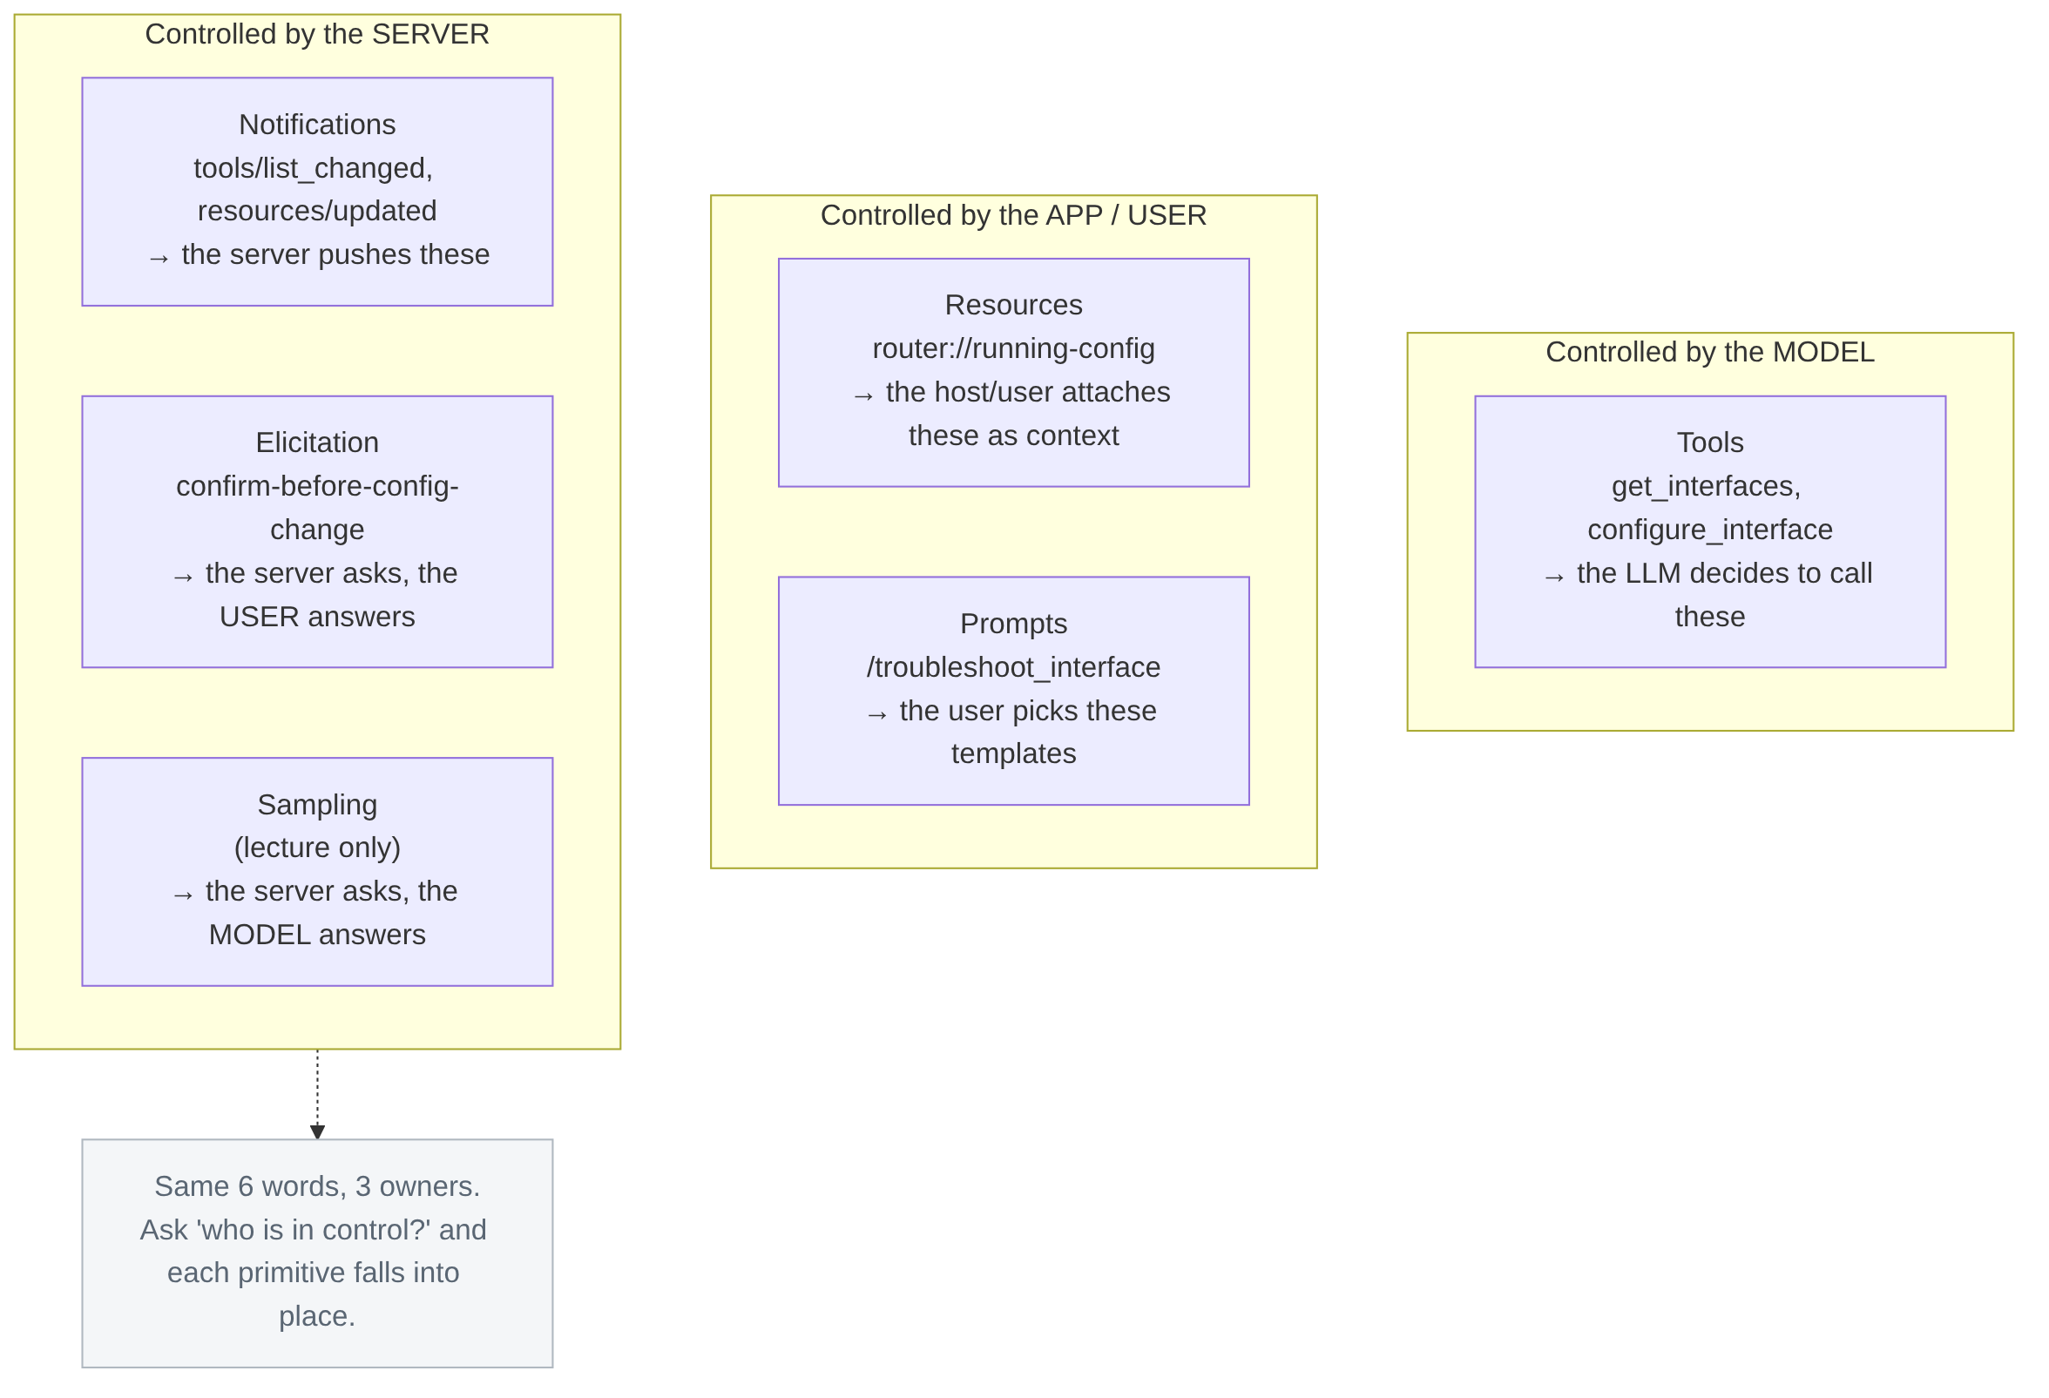
Six primitives, three control points
Six primitives sort into three control points — the model calls Tools; the app/user supplies Resources & Prompts; the server drives Notifications, Elicitation, and Sampling.

Slide 43

TOOLS CAPABILITY — TECHNICAL IMPLEMENTATION
Protocol Methods & Examples
Tools Protocol Methods
Tool Definition Example — schema.json
tools/list
Get available tools from the server
{
"name": "get_weather",
"description": "Get current weather for a location",
"inputSchema": {
"type": "object",
"properties": {
"location": {
"type": "string",
"description": "City name"
}
},
"required": ["location"]
}
}
tools/call
Invoke a specific tool with arguments
Key Execution Concepts
Discovery: Client calls tools/list to inspect parameters and schemas.
Invocation: Client submits structured arguments using tools/call.
Validation: Server validates inputs against defined JSON schema definitions before execution.

Slide 44

TOOLS CAPABILITY — TECHNICAL IMPLEMENTATION (CONTINUED)
Tool Invocation Example
JSON-RPC Request (tools/call)
JSON-RPC Response
// Request
{
"jsonrpc": "2.0",
"id": 1,
"method": "tools/call",
"params": {
"name": "get_weather",
"arguments": {
"location": "San Francisco"
}
}
}
// Response
{
"jsonrpc": "2.0",
"id": 1,
"result": {
"content": [{
"type": "text",
"text": "Temperature: 62°F, Partly cloudy"
}]
}
}

Slide 45
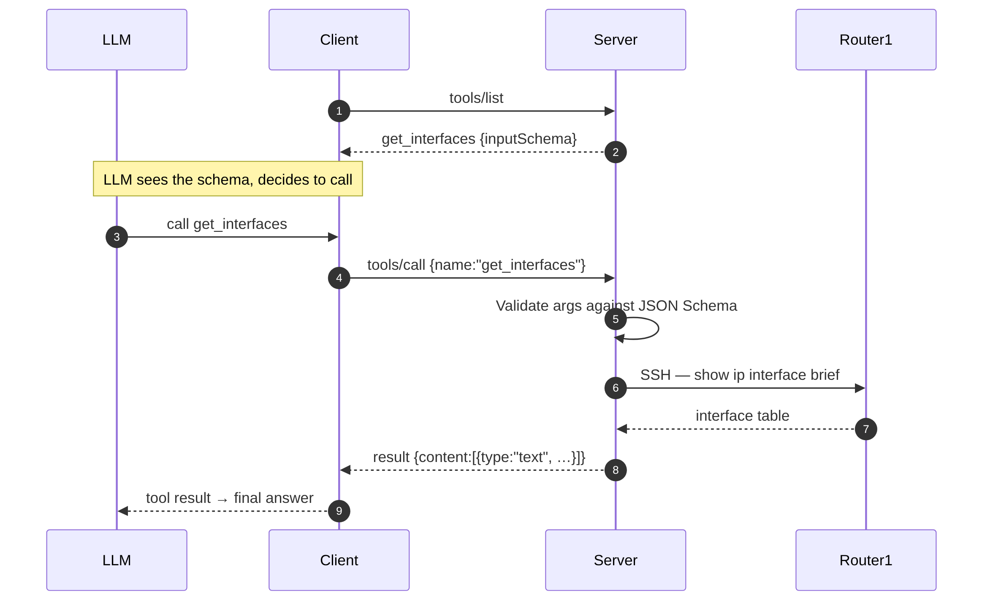
Tools (discovery → invocation → validation → result)
The model discovers a tool's schema, calls it, the server validates the inputs, runs the action, and returns a structured result the model reads.

Slide 46
TOOLS CAPABILITY — FASTMCP IMPLEMENTATION
Tools — Model-Controlled Actions
A FastMCP tool from the server you run today. The docstring IS the prompt engineering:
FastMCP Tool Implementation — router_service.py
@mcp.tool(annotations=types.ToolAnnotations(readOnlyHint=True))
async def get_interfaces(ctx: Context) -> str:
"""
Get all router interfaces and their status (show ip interface brief).
"""
await ctx.report_progress(0, 1, "Connecting to Router1 over SSH...")
...
Automatic Schema & Mapping
Function name → tool name
docstring → description the LLM reads
type hints → JSON Schema (generated)
Error Resilience
Errors return as text results, never exceptions — so the model can read them and retry.

Slide 47
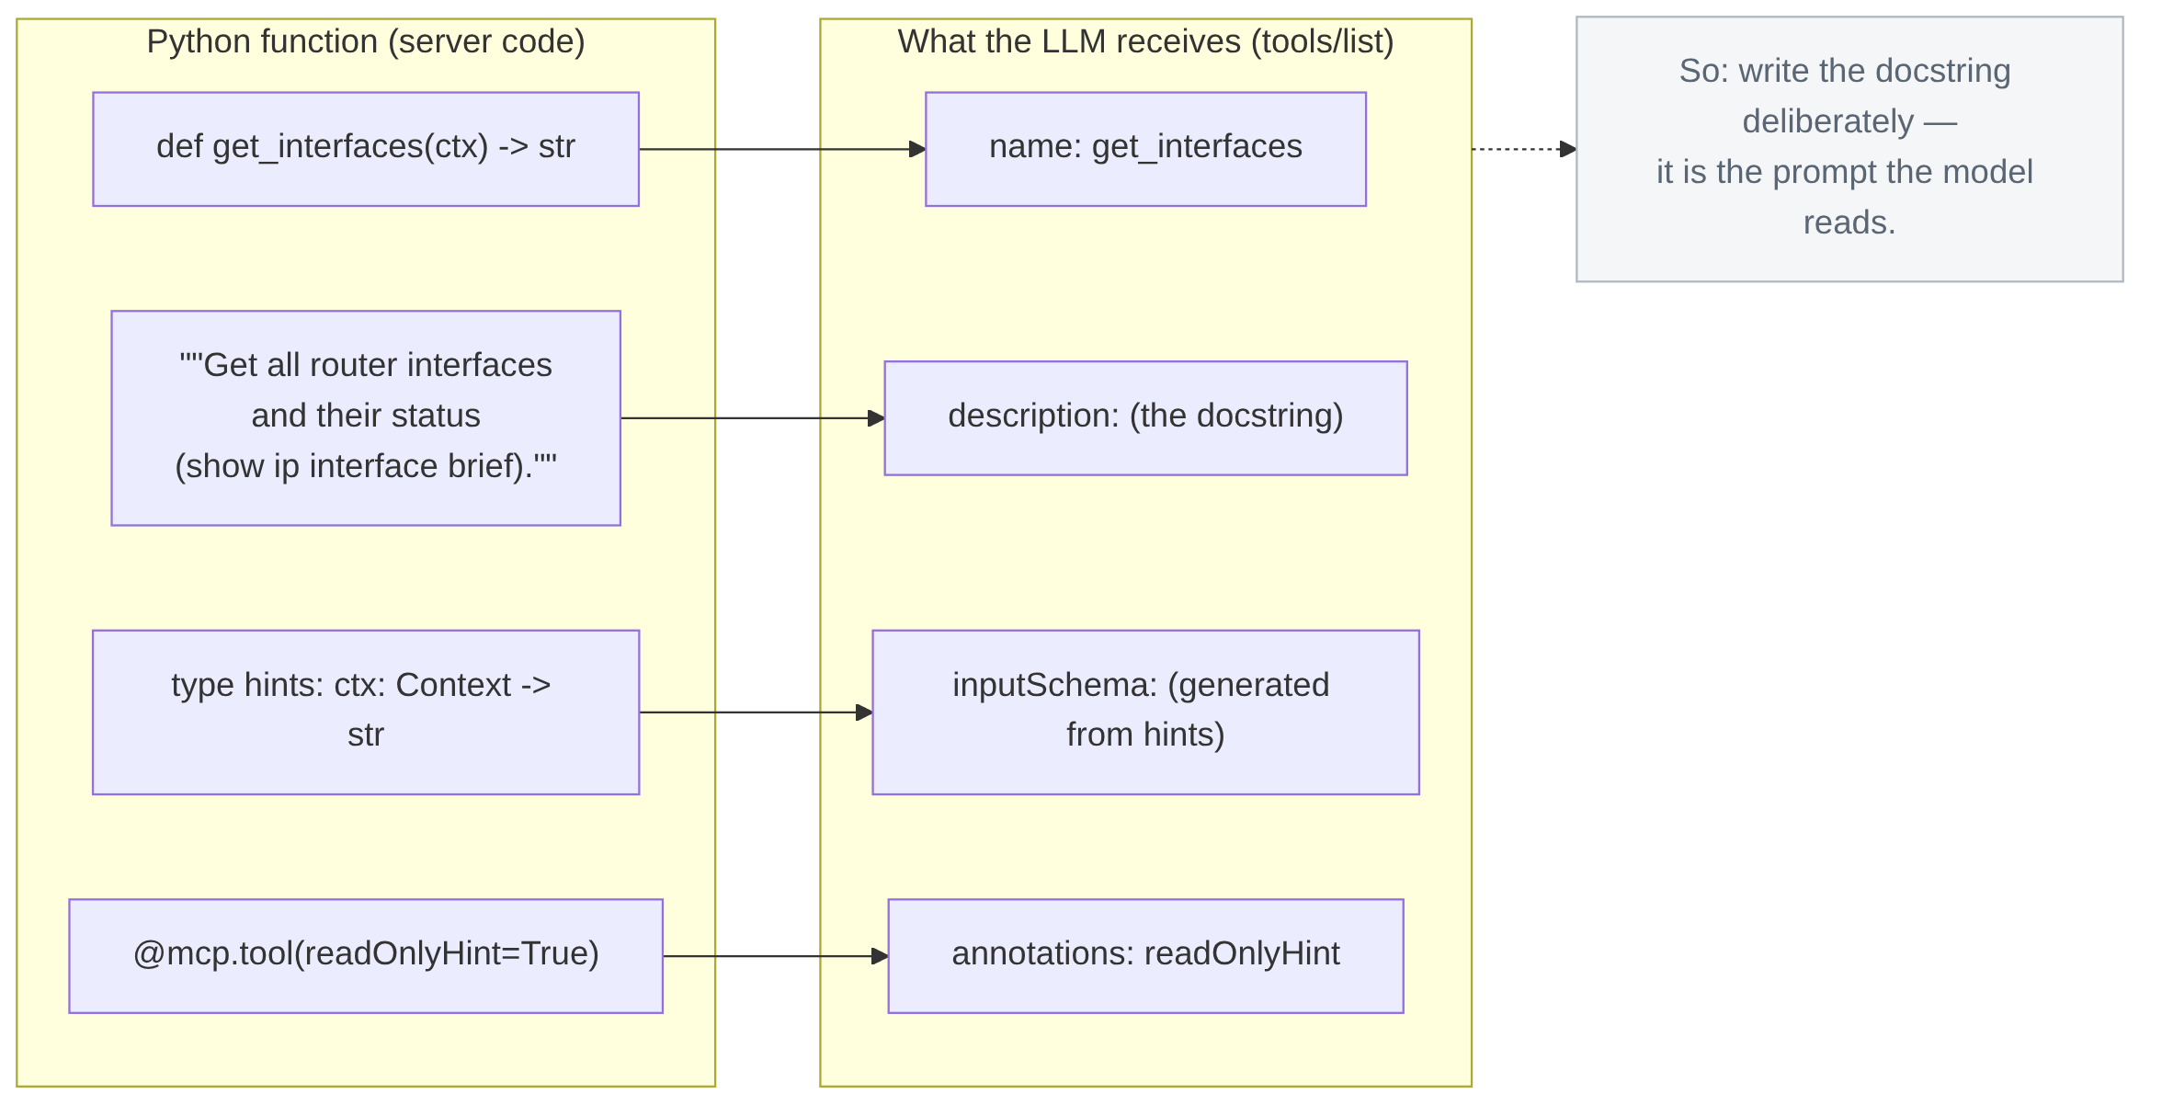
Tools: FastMCP mapping (the docstring IS the prompt)
FastMCP turns the function name into the tool name, the docstring into the description the LLM reads, and the type hints into the JSON Schema. The docstring is prompt engineering.

Slide 48

Protocol Methods & Examples
Resource Protocol Methods
resources/list
Get available resources from server
resources/read
Read a specific resource's content
resources/subscribe
Subscribe to resource updates
resources/unsubscribe
Unsubscribe from updates
Technical Implementation
Resource
Capability
Overview of available protocol endpoints and JSON definition schema for resource objects.
Resource Definition Example
resource_definition.json
{
"uri": "file:///project/README.md",
"name": "Project README",
"description": "Main project documentation",
"mimeType": "text/markdown"
}

Slide 49

Protocol Methods & Examples
Resource Read Example
resources_read_payload.json
// Request
{
"jsonrpc": "2.0",
"id": 1,
"method": "resources/read",
"params": {
"uri": "file:///project/README.md"
}
}
// Response
{
"jsonrpc": "2.0",
"id": 1,
"result": {
"contents": [
{
"uri": "file:///project/README.md",
"mimeType": "text/markdown",
"text": "# Project Overview..."
}
]
}
}
TECHNICAL IMPLEMENTATION
Resource
Capability
(continued)
Overview of available protocol endpoints and JSON request/response schema for reading resource contents.
Criterion Proprietary & Confidential

Slide 50
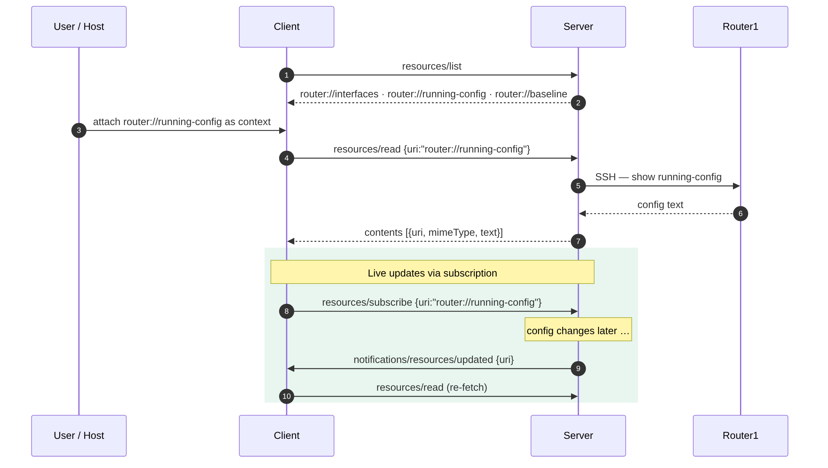
Resources (app-controlled context + subscriptions)
Resources are read-only context the app/user chooses to attach. Subscribe once and the server notifies the client whenever that resource changes.

Slide 51




Protocol Methods & Examples
Prompts Protocol Methods
prompts/list
Get available prompt templates from the server
prompts/get
Retrieve a specific prompt template with arguments
Technical Implementation
Prompts
Capability
Overview of available protocol endpoints and JSON definition schema for prompt templates.
Prompt Definition Example
prompt_definition.json
{
"name": "code_review",
"description": "Review code for best practices",
"arguments": [
{
"name": "language",
"description": "Programming language",
"required": true
}
]
}

Slide 52
Protocol Methods & Examples
Prompt Usage Example
prompt_usage_payload.json
// Request
{
"jsonrpc": "2.0",
"id": 1,
"method": "prompts/get",
"params": {
"name": "code_review",
"arguments": { "language": "Python" }
}
}
// Response
{
"jsonrpc": "2.0",
"id": 1,
"result": {
"messages": [
{
"role": "user",
"content": {
"type": "text",
"text": "Review this Python code..."
}
}
]
}
}
TECHNICAL IMPLEMENTATION
Prompts
Capability
(continued)
Overview of JSON request and response schema for fetching and executing prompt templates.
Criterion Proprietary & Confidential

Slide 53
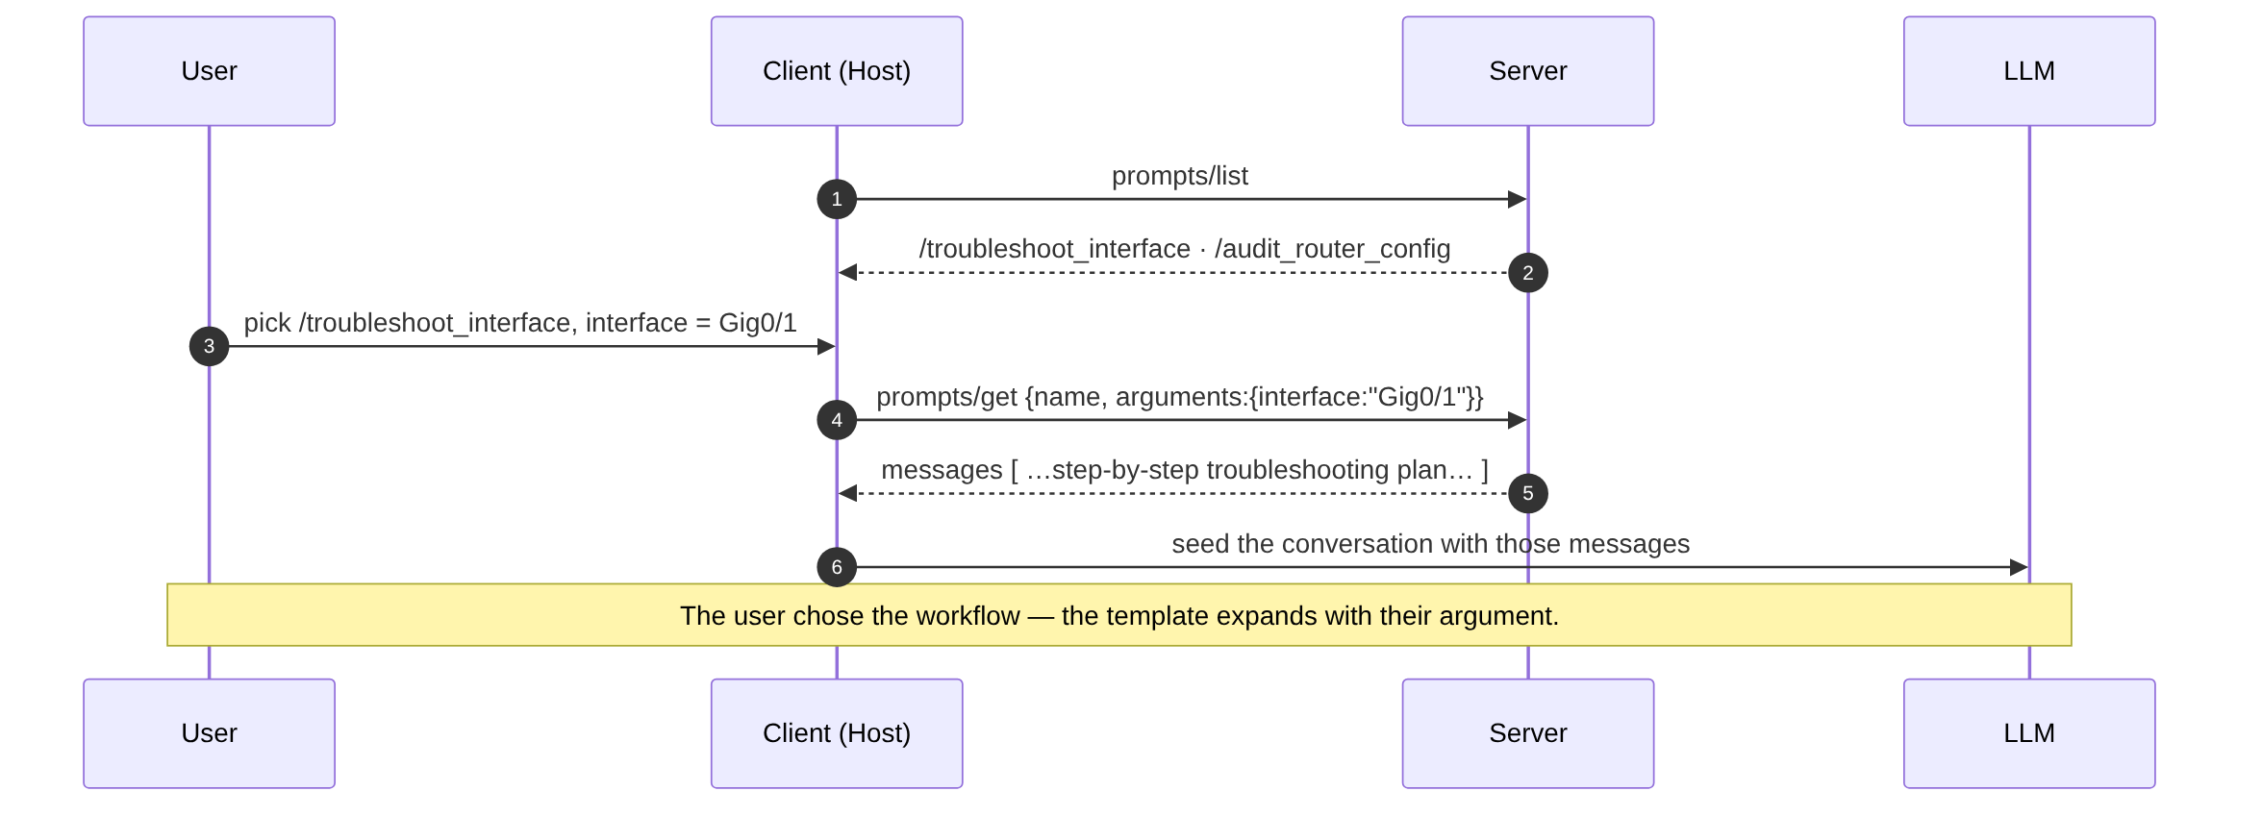
Prompts (user-controlled templates)
Prompts are reusable, parameterized templates the user invokes (like a slash command). The server fills in the arguments and returns ready-to-run messages.

Slide 54
Protocol Methods & Examples
Elicitation Protocol Overview
Elicitation Protocol
Allows servers to request user input through the client. The server specifies the type of input needed and the client prompts the user accordingly.
Technical Implementation
Elicitation
Capability
Overview of client user input request protocol specifications and schemas.
Supported Input Types
text
Free-form text input
number
Numeric input
boolean
Yes/no or true/false
select
Choice from predefined options
elicitation_payload.json
// Request
{
"jsonrpc": "2.0",
"id": 1,
"method": "elicitation/request",
"params": {
"prompt": "Enter API key",
"inputType": "text"
}
}
// Response
{
"jsonrpc": "2.0",
"id": 1,
"result": {
"input": "sk-abc123..."
}
}
Criterion Proprietary & Confidential

Slide 55
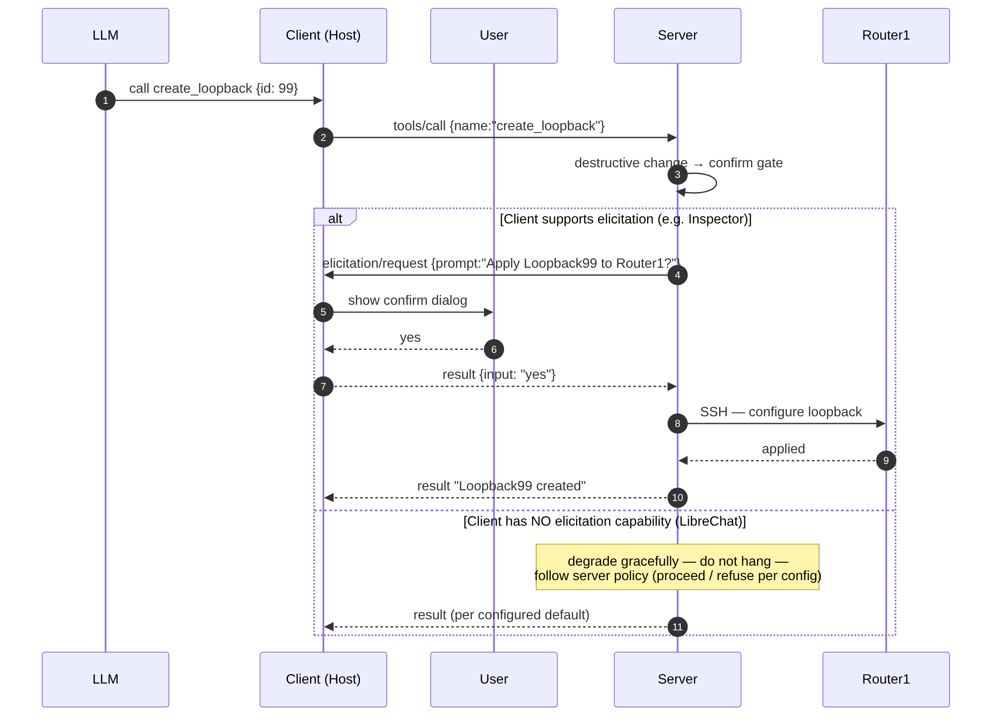
Elicitation (server asks, user answers) + graceful degrade
Elicitation lets the server pause mid-tool to ask the user a question. Clients without the capability don't break — the server degrades gracefully instead of hanging.

Slide 56
Protocol Methods & Examples
Notification Types & Implementation
Notification Types
One-way messages sent from server to client without expecting a response.
1. Capability Updates
notifications/initialized
Server ready after initialization
notifications/tools/list_changed
Available tools updated
notifications/resources/list_changed
Resource list changed
2. Resource Updates
notifications/resources/updated
Specific resource content changed
Includes URI parameter to identify the updated resource
TECHNICAL IMPLEMENTATION
Notification
System
Overview of server-to-client one-way notification events, capability changes, resource updates, and progress tracking.
notifications_progress_payload.json
3. Progress Updates
Track long-running operations with progress token, current value, and total.
Key Parameters:
progressToken: Operation identifier
progress: Current numerical step
total: Target completion count
// JSON-RPC Notification Payload
{
"jsonrpc": "2.0",
"method": "notifications/progress",
"params": {
"progressToken": "task-123",
"progress": 50,
"total": 100
}
}
Criterion Proprietary & Confidential

Slide 57
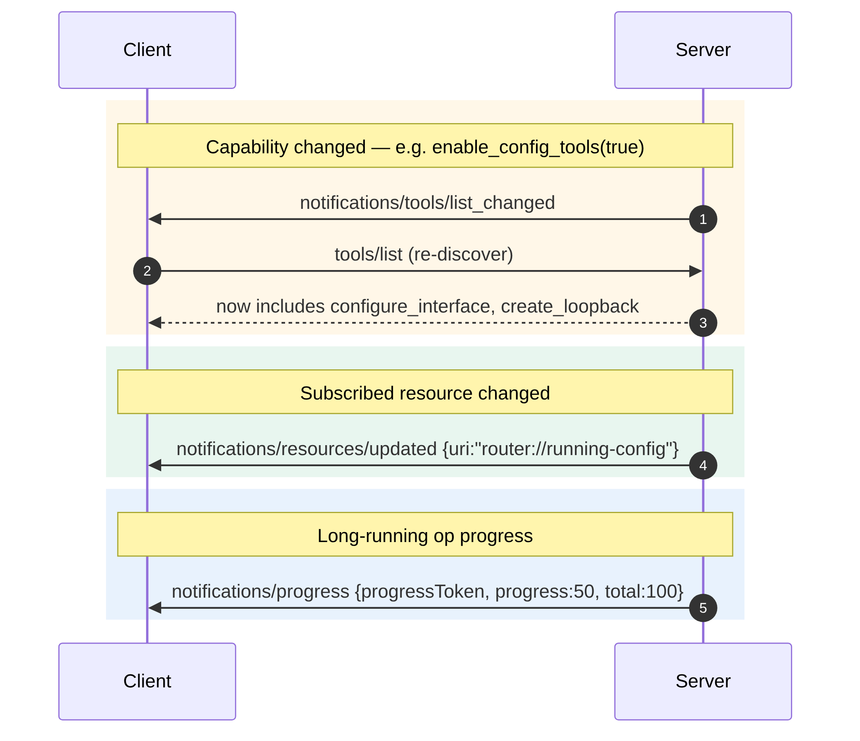
Notifications (server-controlled, one-way)
Notifications are one-way pushes from server to client — new tools appeared, a resource changed, or work is progressing. No `id`, no reply.

Slide 58
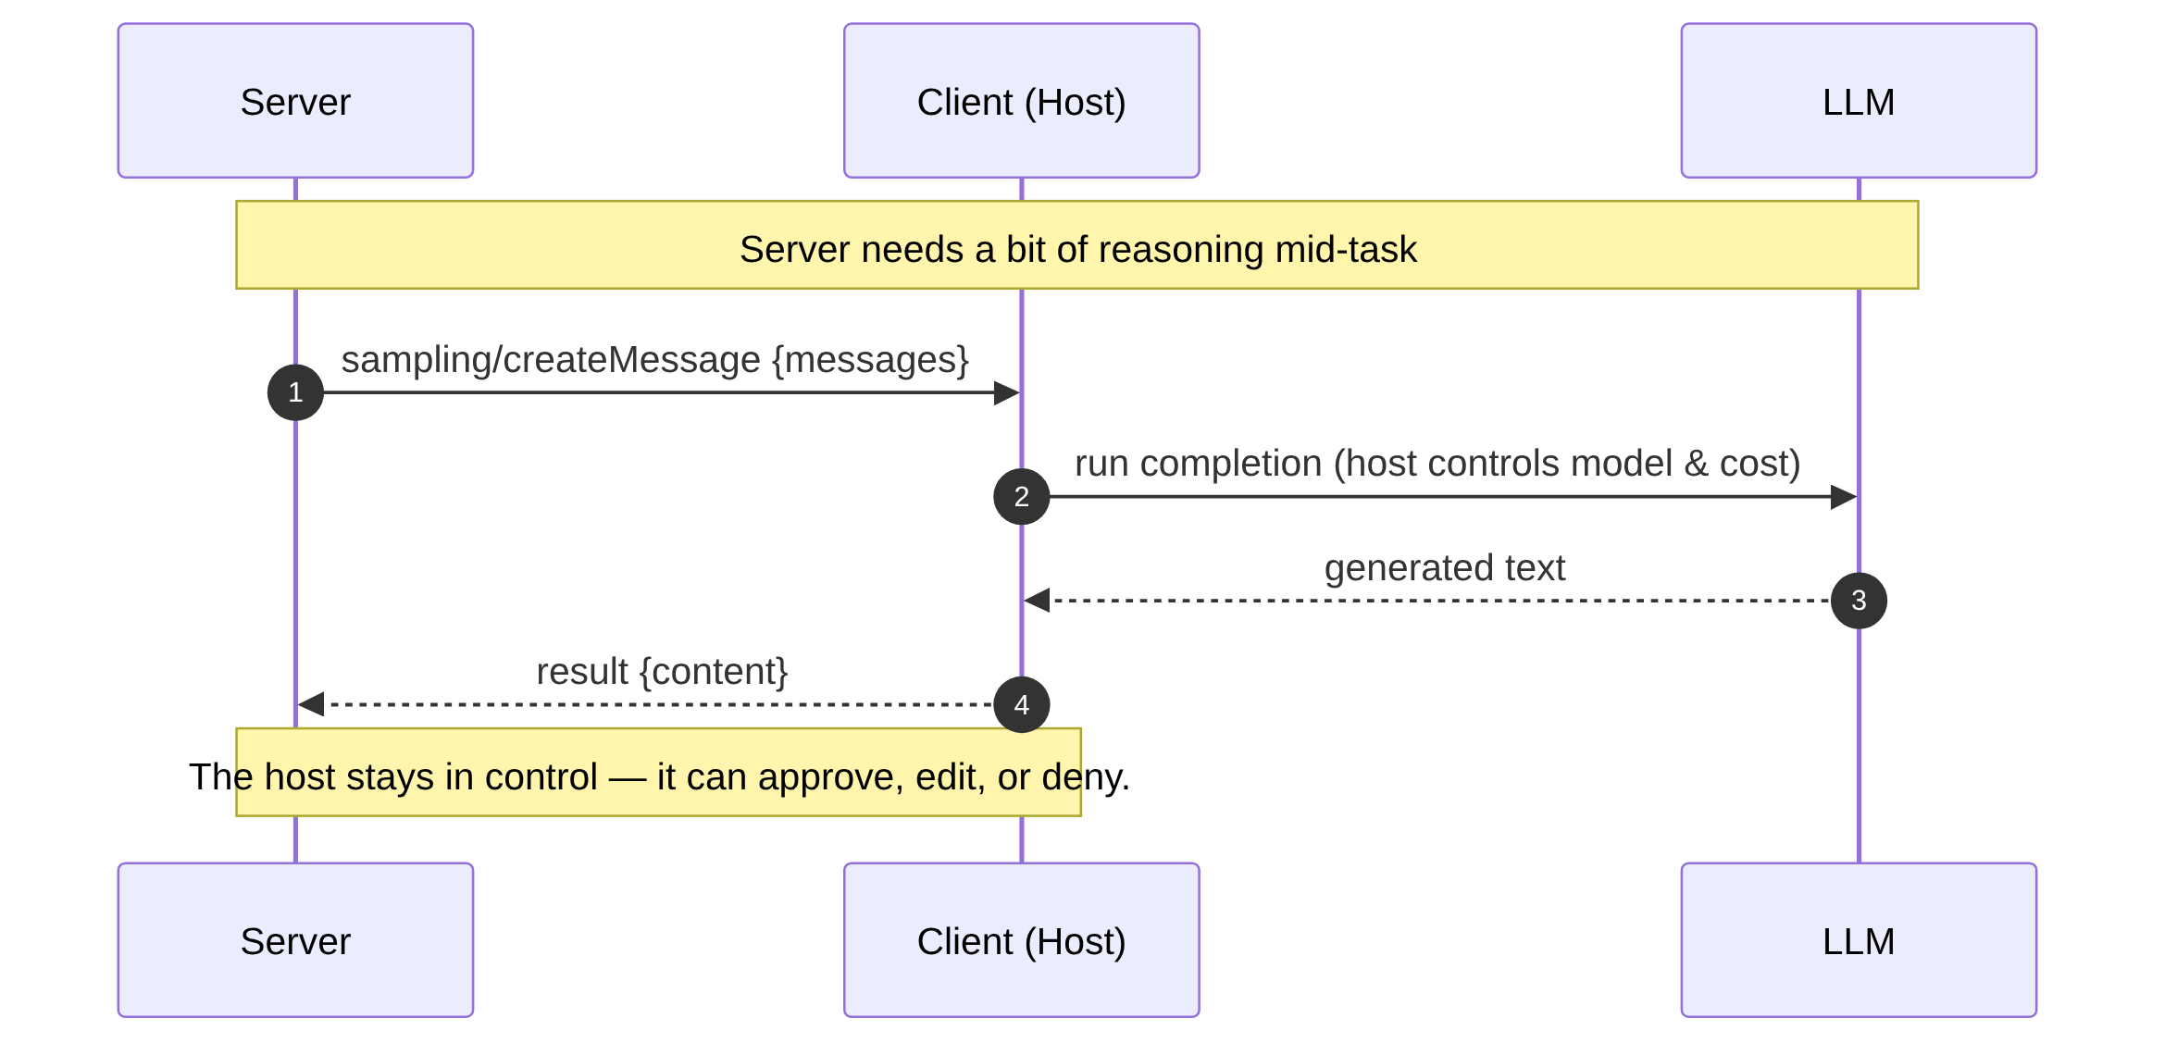
Sampling (lecture only: server asks, model answers)
Sampling flips the direction — the server asks the client's model to think. The host mediates, so it keeps control of cost and safety. (Lecture only; not consumed by the lab client.)

Slide 59
Protocol Methods & Examples
Error Response Format & Recovery Strategies
error_response.json
Common Error Scenarios & Recovery Mechanisms
// JSON-RPC 2.0 Error Response
{
"jsonrpc": "2.0",
"id": 1,
"error": {
"code": -32601,
"message": "Method not found",
"data": { "method": "unknown/method" }
}
}
• Exponential Backoff: Implement exponential backoff for transient retryable errors
• Payload Validation: Validate requests prior to dispatch to prevent -32602 errors
• Capability Caching: Cache capability discovery results to avoid repeated -32005 failures
• User Prompt Guidance: Present clear prompts on -32004 sampling denials
• Contextual Logging: Capture complete error context to streamline post-mortem debugging
TECHNICAL IMPLEMENTATION
Error Handling
& Status Codes
JSON-RPC 2.0 error specifications, standard & MCP-specific error codes, and recovery mechanisms.
Standard JSON-RPC Error Codes
MCP-Specific Error Codes
-32700 — Parse error (Invalid JSON received)
-32600 — Invalid Request (JSON-RPC request malformed)
-32601 — Method not found (Requested method does not exist)
-32602 — Invalid params (Invalid method parameters)
-32603 — Internal error (Server-side processing error)
-32001 — Resource not found
-32002 — Tool execution failed
-32003 — Prompt not found
-32004 — Sampling denied by user
-32005 — Capability not supported
-32006 — Connection timeout
Criterion Proprietary & Confidential

Slide 60
Protocol Security Controls
Security Architecture & Safeguards
1. Transport Security
TLS 1.3+ for encrypted communication
Certificate validation and mutual TLS support
2. Authentication & Authorization
OAuth 2.0 / JWT token-based authentication
Role-based access control (RBAC)
Capability-based permissions
TECHNICAL IMPLEMENTATION
Security
Implementation
Overview of transport encryption, authentication & authorization, content validation, human controls, and security best practices.
3. Content Validation
Input sanitization and validation
Output filtering and escaping
Schema validation for all messages
4. Human-in-the-Loop Controls
User approval for sensitive operations (sampling, tool execution)
Audit logging and monitoring
Rate limiting and quota management
Implementation Recommendations
Zero Trust Inputs: Never trust client-provided data without validation
Defense-in-Depth: Implement layered security controls across all vectors
Least Privilege: Restrict all capabilities to minimum needed access
Credential Hygiene: Regularly audit and rotate access credentials
Continuous Monitoring: Monitor for anomalous behavior patterns
Criterion Proprietary & Confidential

Slide 61
SDK Architecture & Code Examples
Supported Language Implementations & FastMCP Server
Supported Language SDKs
server_example.py
TypeScript
Official reference implementation
// Server SDK Example (Python)
from fastmcp import FastMCP
mcp = FastMCP("MyServer")
@mcp.tool
def multiply(a: float, b: float) -> float:
"""Multiplies two numbers together."""
return a * b
@mcp.resource("data://config")
def get_config() -> dict:
return {"theme": "dark", "version": "1.0"}
@mcp.prompt
def analyze_data(data_points: list[float]) -> str:
formatted_data = ", ".join(str(point) for point in data_points)
return f"Please analyze these data points: {formatted_data}"
if __name__ == "__main__":
mcp.run(transport="http", host="127.0.0.1", port=9000)
TECHNICAL IMPLEMENTATION
SDK Architecture
& Examples
Official SDKs for multiple languages and complete FastMCP Python server-side implementation.
Python
Full-featured client & server
Rust
High-performance implementation
Go
Lightweight and efficient
Java
Enterprise-ready
C#
.NET integration
Criterion Proprietary & Confidential

Slide 62
SDK Architecture & Code Examples
Supported Language Implementations & FastMCP Client Example
Supported Language SDKs
client_example.py
TypeScript
Official reference implementation
# Client SDK Example (Python)
# In-memory server (ideal for testing)
server = FastMCP("TestServer")
client = Client(server)
# HTTP server
client = Client("[link removed]")
# Local Python script
client = Client("my_mcp_server.py")
async def main():
async with client:
# List available operations
tools = await client.list_tools()
resources = await client.list_resources()
prompts = await client.list_prompts()
# Execute operations
result = await client.call_tool("example_tool", {"param": "value"})
print(result)
TECHNICAL IMPLEMENTATION
SDK Architecture
& Examples
Official SDKs for multiple languages and complete client & server Python implementations.
Python
Full-featured client & server
Rust
High-performance implementation
Go
Lightweight and efficient
Java
Enterprise-ready
C#
.NET integration
Criterion Proprietary & Confidential

Slide 63
Protocol Extensions & Future Roadmap
Extensibility Architecture & Planned Features
Extension Mechanisms
Capability Discovery
Clients can query server capabilities dynamically to discover supported features.
Custom Methods
Servers can implement vendor-specific extensions using custom method namespaces.
Protocol Versioning
Backward-compatible version negotiation ensures interoperability across versions.
PROTOCOL ROADMAP
Protocol
Extensions &
Future Roadmap
Extensible architecture built for modular capabilities, custom vendor features, and seamless backward compatibility.
Upcoming Features
Streaming Support
For large data transfers and real-time updates.
Enhanced Security
With fine-grained permissions and access controls.
Multi-Server Orchestration
Capabilities for complex workflows.
Improved Developer Tooling
And debugging support.
Community-Driven Protocol Extensions
Through standardized extension mechanisms.
MCP is designed for extensibility while maintaining backward compatibility
Criterion Proprietary & Confidential

Slide 64
The Big Picture — Client · Server · Router
⇄
MCP-Client (desktop)
172.18.0.2
MCP
Streamable HTTP
:8000/mcp · Bearer
MCP-Server (desktop)
172.18.1.2
Netmiko SSH
show / config
Router1
172.18.2.6
Lab network
public-internet2
→ switch
Host application
LibreChat
MCP server script
FastMCP · app/main.py
Cisco IOS device
(the thing we actually
read & configure)
MCP Client
Tools: get_interfaces · configure_interface
One flow: you ask LibreChat → its MCP client calls the server over MCP → the server's tools SSH into Router1 → the answer comes back to you.

Slide 65
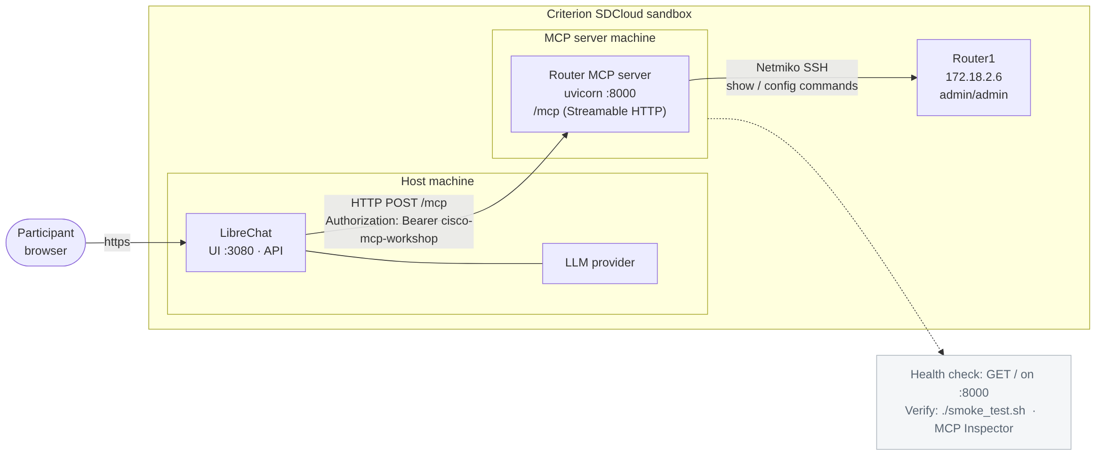
Workshop lab topology
The whole lab in one picture — your browser → LibreChat (:3080) → MCP server (:8000/mcp, bearer token) → SSH → Router1. LibreChat is the MCP host/client; the server drives the real device.

Slide 66
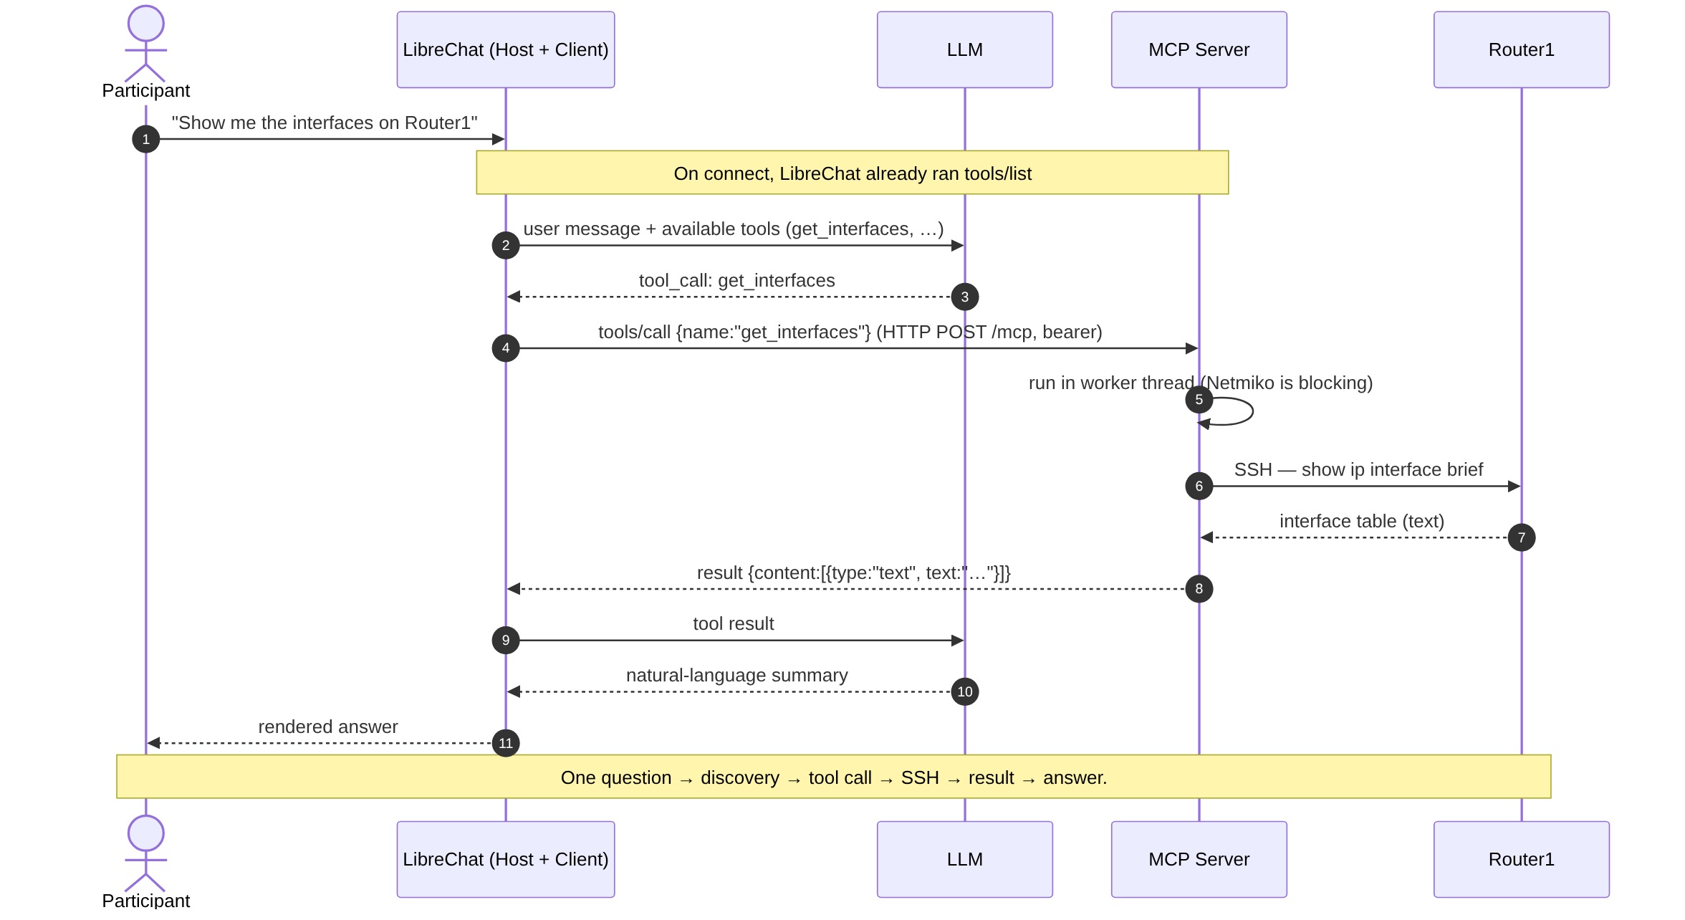
End-to-end query flow ("show me the interfaces")
A single question travels: LibreChat gives the LLM the tool list, the LLM picks `get_interfaces`, LibreChat calls the server, the server SSHes to Router1, and the result flows back as a plain-English answer.

Slide 67
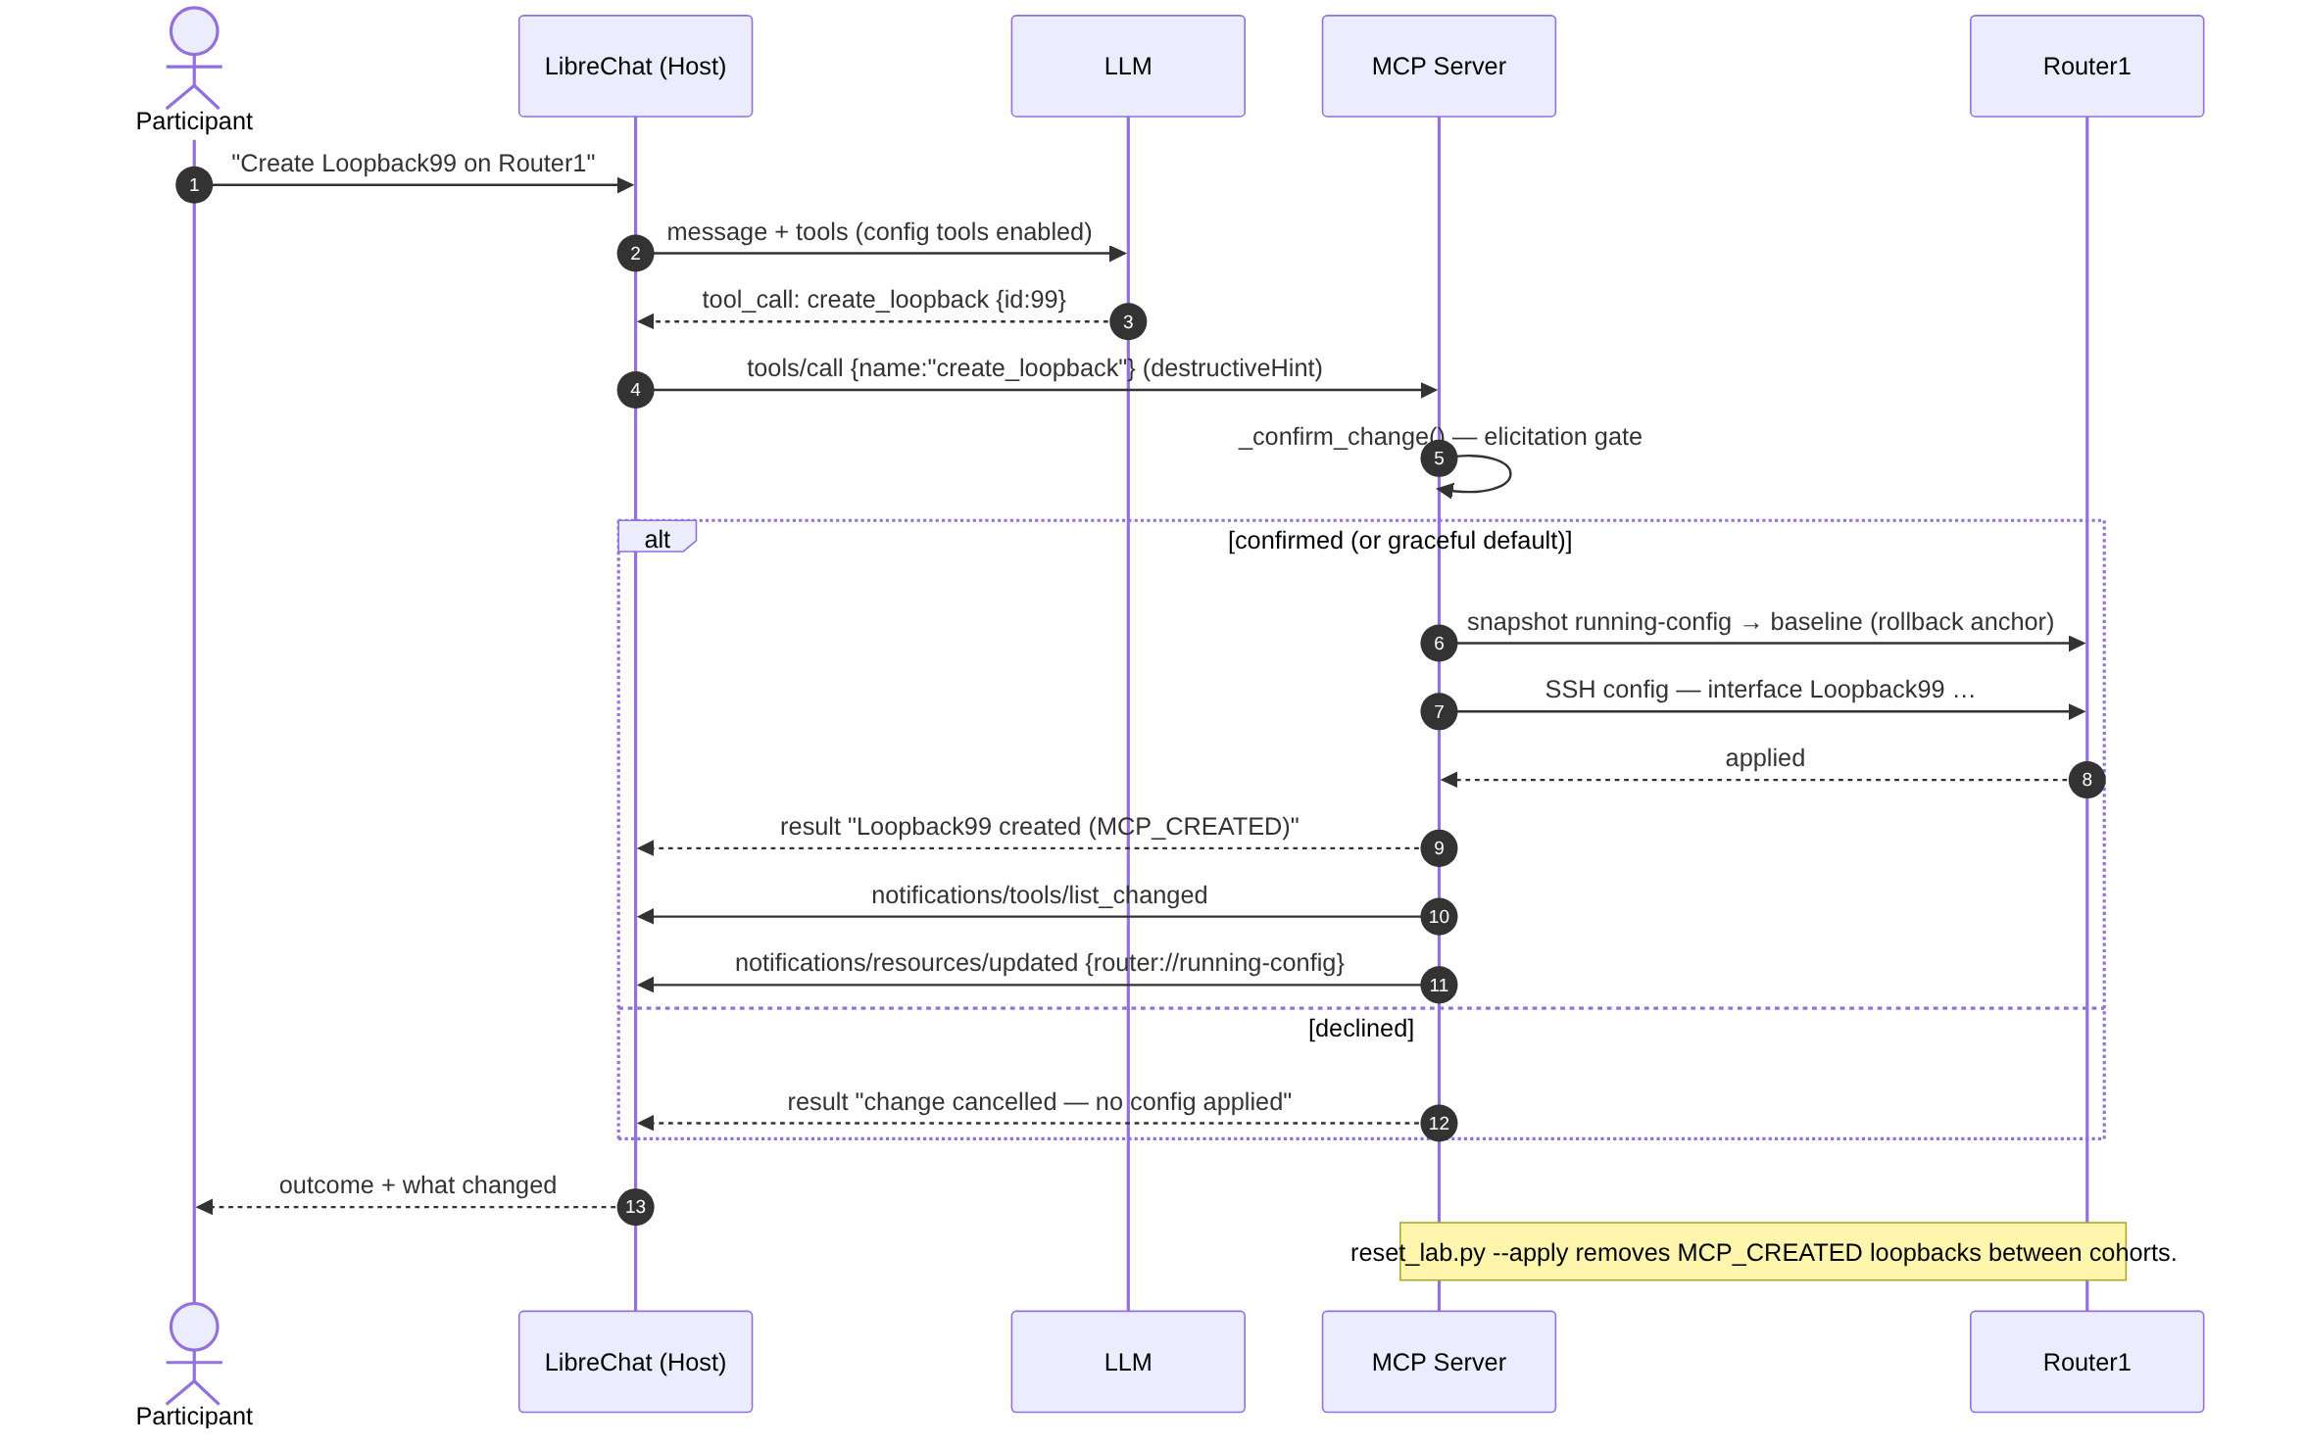
Config change with the safety gate (rollback-aware)
Config-writing tools are gated: confirm first, snapshot a rollback baseline, apply, then push notifications so the client re-discovers state. Safe-by-default, auditable, reversible.

Slide 68
What the MCP Inspector shows (end-of-session debugger)
The Inspector connects to the same `/mcp` endpoint and exposes each primitive on its own tab — the clearest way to watch the raw JSON-RPC once you understand the flow.

Slide 69





Connect any AI to any data source
Universal AI Connectivity
Eliminate vendor lock-in
Standardized protocol across platforms
The
Future
of AI
Mix and match AI capabilities
Composable Intelligence
Build custom workflows
Integration with
MCP
Reusable components and tools
Lower barriers to AI adoption
Democratized AI Access
Open-source and community-driven
Accessible to developers of all levels

Slide 70
Industry Vision & Impact
Defining the Standard for AI Connectivity
Featured Insight
INDUSTRY PERSPECTIVE
The Future
of AI Integration
with MCP
Key takeaways and industry recognition on Model Context Protocol as the new open standard.
format_quote
"MCP represents a fundamental shift in how AI systems integrate with the world"
ANTHROPIC
Official Announcement, 2024
01 / OPEN STANDARD
02 / ARCHITECTURE
03 / ECOSYSTEM
Universal Connectivity
Replaces fragmented custom connectors with a single, open protocol across data sources and AI models.
Composable Systems
Enables modular architecture where tools, prompts, and resources can be dynamically exposed and discovered.
Rapid Adoption
Empowers developers with official SDKs and community extensions to build future-proof AI integrations.
Criterion Proprietary & Confidential

Slide 71


THANK YOU

